Slide 1
Introduction to
Data Science
José Manuel Calderón Trilla
Lecture #1 – 01/25/2021
CMSC320
Mondays & Wednesdays
5:00pm – 6:15pm
Notes:
<number>

Slide 2
Introduction to
?????????????

Slide 3
Data science is the application of computational and statistical techniques to address or gain [managerial or scientific] insight into some problem in the real world.
Zico Kolter
Machine Learning Prof, CMU
2

Slide 4
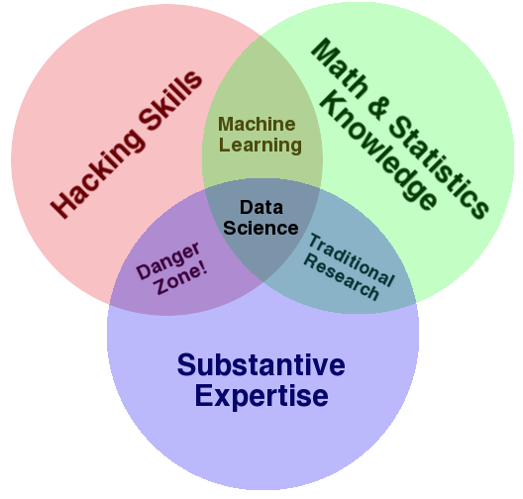
Drew Conway
CEO, Alluvium (analytics company)
2

Slide 5
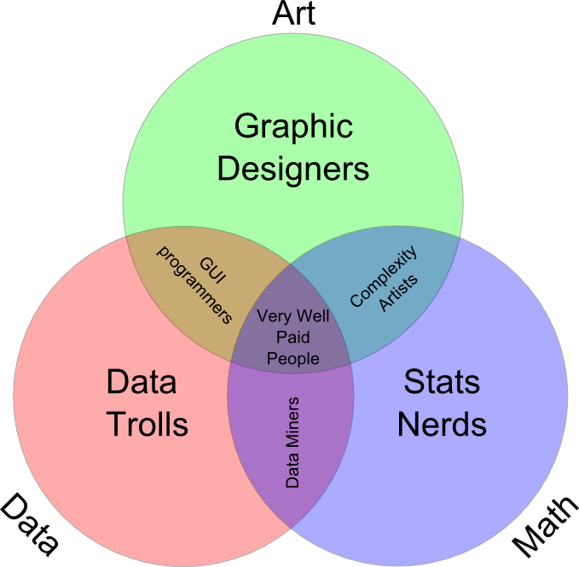
Many definitions
Broad: necessarily larger than a single discipline
Interdisciplinary: statistics, computer science, operations research, statistical and machine learning, data warehousing, visualization, mathematics, information science, …
Insight-focused: grounded in the desire to find insights in data and leverage them to inform decision making
Tuomas Carsey, UNC
2

Slide 6
The Data LifeCycle
Data collection
Data processing
Exploratory analysis
&
Data viz
Analysis, hypothesis testing, & ML
Insight & Policy Decision
2
Notes:
<number>

Slide 7
“The ability to take data—to be able to understand it, to process it, to extract value from it, to visualize it, to communicate it—that’s going to be a hugely important skill in the next decades, not only at the professional level but even at the educational level for elementary school kids, for high school kids, for college kids.”
Hal Varian
Chief Economist at Google
<number>

Slide 8
This Course
You’ll learn to take data:
Process it
Visualize it
Understand it
Communicate it
Extract value from it
Info: https://cmsc320.github.io/
Piazza: https://piazza.com/terpmail.umd/spring2021/cmsc320
ELMS: (everyone should be registered automatically)
Zoom: Information is on ELMS
Hal Varian
<number>

Slide 9
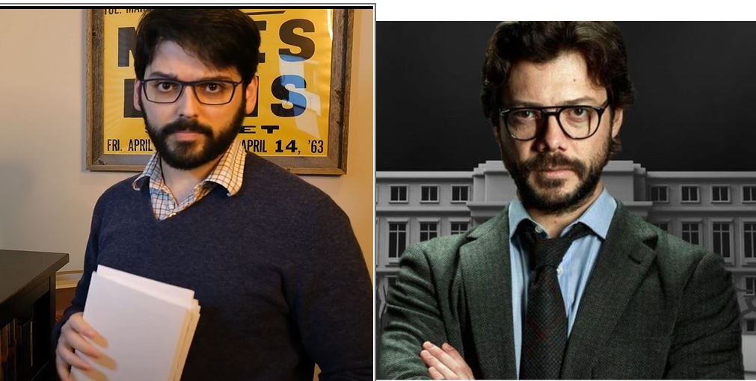
My Emphasis
You’ll learn to take data:
Process it
Visualize it
Understand it
COMMUNICATE it
Extract value from it
One of these is me
<number>

Slide 10
Prerequisite Knowledge
Aimed at CMSC undergrads – but likely accessible to others with programming experience and mathematical maturity.
We do not assume:
Experience with Python, pandas, scikit-learn, matplotlib, etc …
Deep statistics or any ML knowledge
Database or distributed systems knowledge
We do assume:
You want to be here!
<number>

Slide 11



Who am I?
http://jmct.cc
<number>

Slide 12
Who are you?
2nd-year
STAT400?
3rd-year
CMSC422?
4th-year +
CMSC424?
Register on Piazza/Discord!
<number>

Slide 13
(Tentative) Course structure
First 4 lectures: intro & primers in the Python data science stack
Next 6 lectures: data collection & management
Best practices, data wrangling, exploratory analysis, ethics, debugging, visualization, etc …
Next 9 lectures: statistical modeling & ML
Statistical learning, regression, classification, cross-validation, model evaluation, hypothesis testing, etc …
Midterm
Final 8 lectures: advanced topics
Dimensionality reduction, distributed learning, big data, distributed computation
Ambitious …
<number>

Slide 14
Grade #1: Mini-Projects
Students will complete four mini-project assignments:
Case studies meant to mimic what you, a future data scientist, will see in industry. They should be fun ☺.
The rules:
Allowed: small group discussions
Required: individual programming & writing
Never allowed: public posting of solutions
Deliverable:
Turn in an .ipynb of a Jupyter notebook on ELMS
<number>

Slide 15
Grade #2: Reading Homeworks
We will post (bi)weekly reading assignments. Mix of:
Blog posts
Academic articles
News articles
Weekly quiz to be taken on ELMS covering the readings
Individual quiz grades are pass/fail:
At least 60% correct → Pass
Less than 60% correct → Fail
Must take at least ten of these quizzes over the semester
<number>

Slide 16
Grade #3: Midterm
You know what this is.
Will cover roughly the first 3/5 of class:
Qualitative (more)
Quantitative (less)
Currently scheduled for late March
(might change… might not... stick around to find out)
<number>

Slide 17
Grade #4: Mini-Tutorial
In lieu of a final exam, you’ll create a mini-tutorial that:
Identifies a raw data source
Processes and stores that data
Performs exploratory data analysis & visualization
Derives insight(s) using statistics and ML
Communicates those insights as actionable text
Individual or group project
Will be hosted publicly online (GitHub Pages) and will strengthen your portfolio.
<number>

Slide 18
Ready-Made Dataset repositories
https://www.data.gov/
US-centric agriculture, climate, education, energy, finance, health, manufacturing data, …
https://cloud.google.com/bigquery/public-data/
BigQuery (Google Cloud) public datasets (bikeshare, GitHub, Hacker News, Form 990 non-profits, NOAA, …)
https://www.kaggle.com/datasets
Microsoft-owned, various (Billboard Top 100 lyrics, credit card fraud, crime in Chicago, global terrorism, world happiness, …)
https://aws.amazon.com/public-datasets/
AWS-hosted, various (NASA, a bunch of genome stuff, Google Books n-grams, Multimedia Commons, …)
<number>

Slide 19
New Dataset Ideas
Fraternal Order of Police vs Black Lives Matter
Linking finance data to ${anything_else}
Something having to do with Pokémon statistics?
Look through http://www.alexa.com/topsites and scrape something interesting!
University of Maryland-related, or College Park-related, stuff
Check out http://umd.io/ – open source project; maybe your data collection and cleaning scripts can be added to this!
Honestly, pretty much anything! Just document everything.
Reproducibility!
<number>

Slide 20
Final Tutorial
Deliverable: URL of your own GitHub Pages site hosting an .ipynb/.html export of your final tutorial
https://pages.github.com/ – make a GitHub account, too!
https://github.com/blog/1995-github-jupyter-notebooks-3
The project itself:
~1500+ words of Markdown prose
~150+ lines of Python
Should be viewable as a static webpage – that is, if I (or anyone else) opens the link up, everything should render and I shouldn’t have to run any cells to generate output
<number>

Slide 21
Final Tutorial Rubric
The TAs and I will grade on a scale of 1-10:
Motivation: Does the tutorial make the reader believe the topic is important (a) in general and (b) with respect to data science?
Understanding: After reading the tutorial, does the reader understand the topic?
Further resources: Does the tutorial “call out” to other resources that would help the reader understand basic concepts, deep dive, related work, etc?
Prose: Does the prose in the Markdown portion of the .ipynb add to the reader’s understanding of the tutorial?
Code: Does the code help solidify understanding, is it well documented, and does it include helpful examples?
Subjective Evaluation: If somebody linked to this tutorial from Hacker News, would people actually read the whole thing?
<number>
Thanks to: Zico Kolter

Slide 22
Class Participation
Please please please please please do the required reading, if available, before (virtually) attending class!
Earn brownie points via:
Lecture participation
Piazza participation
Regular participation at office hours
Aim to ask/answer a question at least once every two weeks; or attend office hours at least once a month
<number>

Slide 23
Grade Breakdown
40% mini-projects:
There are 4 of them
Equal weighting @ 10%
10% reading homeworks
25% midterm
25% final tutorial
= A+
<number>

Slide 24
Some Technologies we will use
<number>
Notes:
Docker – containerization, build and ship apps
Spark – cluster computing framework, nice data parallelism etc
<number>

Slide 25
(Don’t tell CMSC330 …)
<number>

Slide 26
Important Walls of Text
<number>

Slide 27
Anti-Harassment
Common Sense!
(Adapted from ACM SIGCOMM’s policies)
The open exchange of ideas and the freedom of thought and expression are central to our aims and goals. These require an environment that recognizes the inherent worth of every person and group, that fosters dignity, understanding, and mutual respect, and that embraces diversity. For these reasons, we are dedicated to providing a harassment-free experience for participants in (and out) of this class.
Harassment is unwelcome or hostile behavior, including speech that intimidates, creates discomfort, or interferes with a person's participation or opportunity for participation, in a conference, event or program.
<number>

Slide 28
Academic Integrity
Common Sense!
(Text unironically stolen from Hal Daumé III)
Any assignment or exam that is handed in must be your own work (unless otherwise stated). However, talking with one another to understand the material better is strongly encouraged. Recognizing the distinction between cheating and cooperation is very important. If you copy someone else's solution, you are cheating. If you let someone else copy your solution, you are cheating (this includes posting solutions online in a public place). If someone dictates a solution to you, you are cheating.
Everything you hand in must be in your own words, and based on your own understanding of the solution. If someone helps you understand the problem during a high-level discussion, you are not cheating. We strongly encourage students to help one another understand the material presented in class, in the book, and general issues relevant to the assignments. When taking an exam, you must work independently. Any collaboration during an exam will be considered cheating. Any student who is caught cheating will be given an F in the course and referred to the University Office of Student Conduct. Please don't take that chance – if you're having trouble understanding the material, please let me know and I will be more than happy to help.
<number>

Slide 29
(A few) Data Science Success Stories & Cautionary Tales
<number>

Slide 30
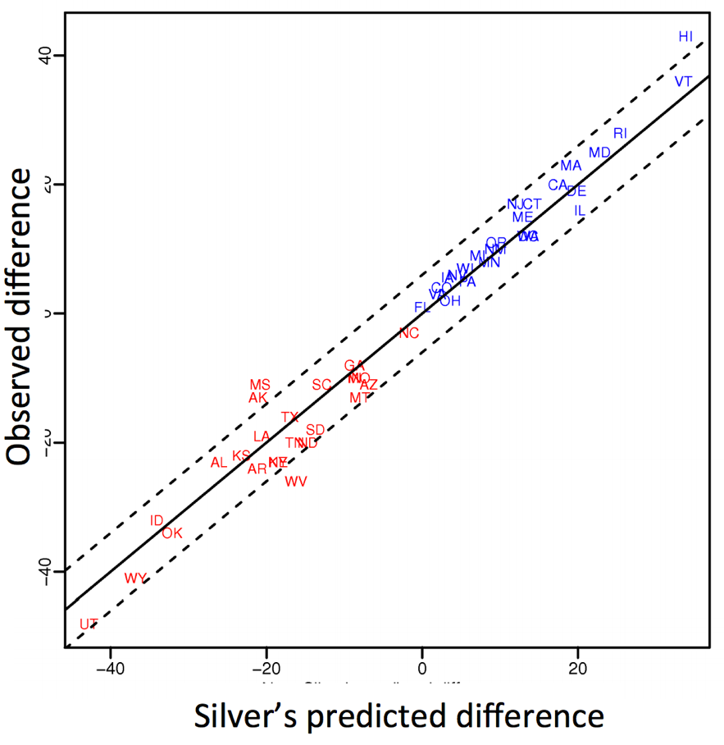
Polling: 2008 & 2012
Nate Silver uses a simple idea – taking a principled approach to aggregating polling instead of relying on punditry – and:
Predicts 49/50 states in 2008
Predicts 50/50 states in 2012
(He is also a great case study
in creating a brand.)
https://hbr.org/2012/11/how-nate-silver-won-the-2012-p
<number>
Democrat (+) or Republican (-) in 2012

Slide 31
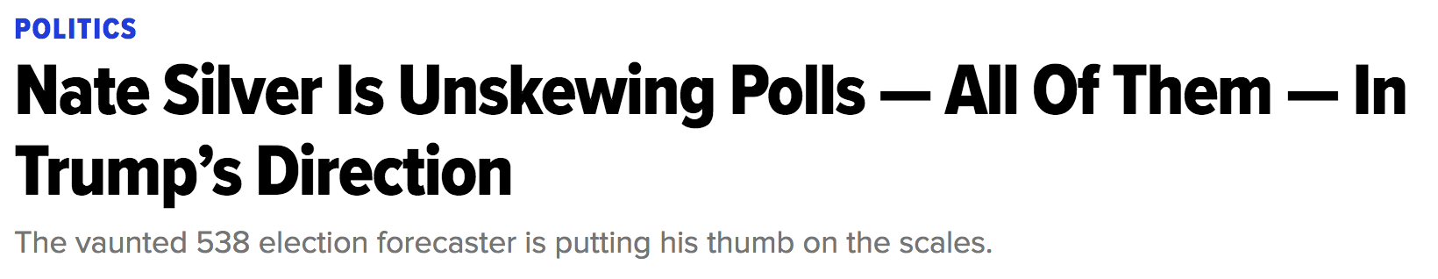
Polling: 2016
HuffPo: “He may end up being right, but he’s just guessing. A “trend line adjustment” is merely political punditry dressed up as sophisticated mathematical modeling.”
538: Offers quantitative reasoning for re-/under-weighting older polls, & changing as election approaches
<number>
http://www.huffingtonpost.com/entry/nate-silver-election-forecast_us_581e1c33e4b0d9ce6fbc6f7f
https://fivethirtyeight.com/features/a-users-guide-to-fivethirtyeights-2016-general-election-forecast/

Slide 32
Ad Targeting
Pregnancy is an expensive & habit-forming time
Thus, valuable to consumer-facing firms
2012:
Target identifies 25 products and subsets thereof that are commonly bought in early pregnancy
Uses purchase history of patrons to predict pregnancy, targets advertising for post-natal products (cribs, etc)
Good: increased revenue
Bad: this can expose pregnancies – as famously happened in Minneapolis to a high schooler
<number>
http://www.businessinsider.com/the-incredible-story-of-how-target-exposed-a-teen-girls-pregnancy-2012-2
Notes:
<number>

Slide 33









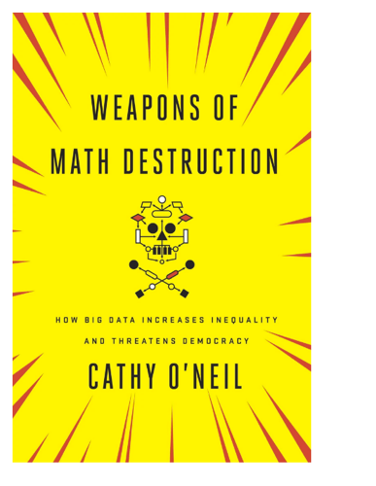
Automated decisions of consequence
[Sweeney 2013, Miller 2015, Byrnes 2016,
Rudin 2013, Barry-Jester et al. 2015]
Hiring
Lending
Policing/
sentencing
Search for minority names →
ads for DUI/arrest records
Female cookies →
less freq. shown professional job opening ads
<number>

Slide 34
“… a lot remains unknown about how big data-driven decisions may or may not use factors that are proxies for race, sex, or other traits that U.S. laws generally prohibit from being used in a wide range of commercial decisions … What can be done to make sure these products and services–and the companies that use them treat consumers fairly and ethically?”
- FTC Commissioner Julie Brill [2015]
<number>

Slide 35
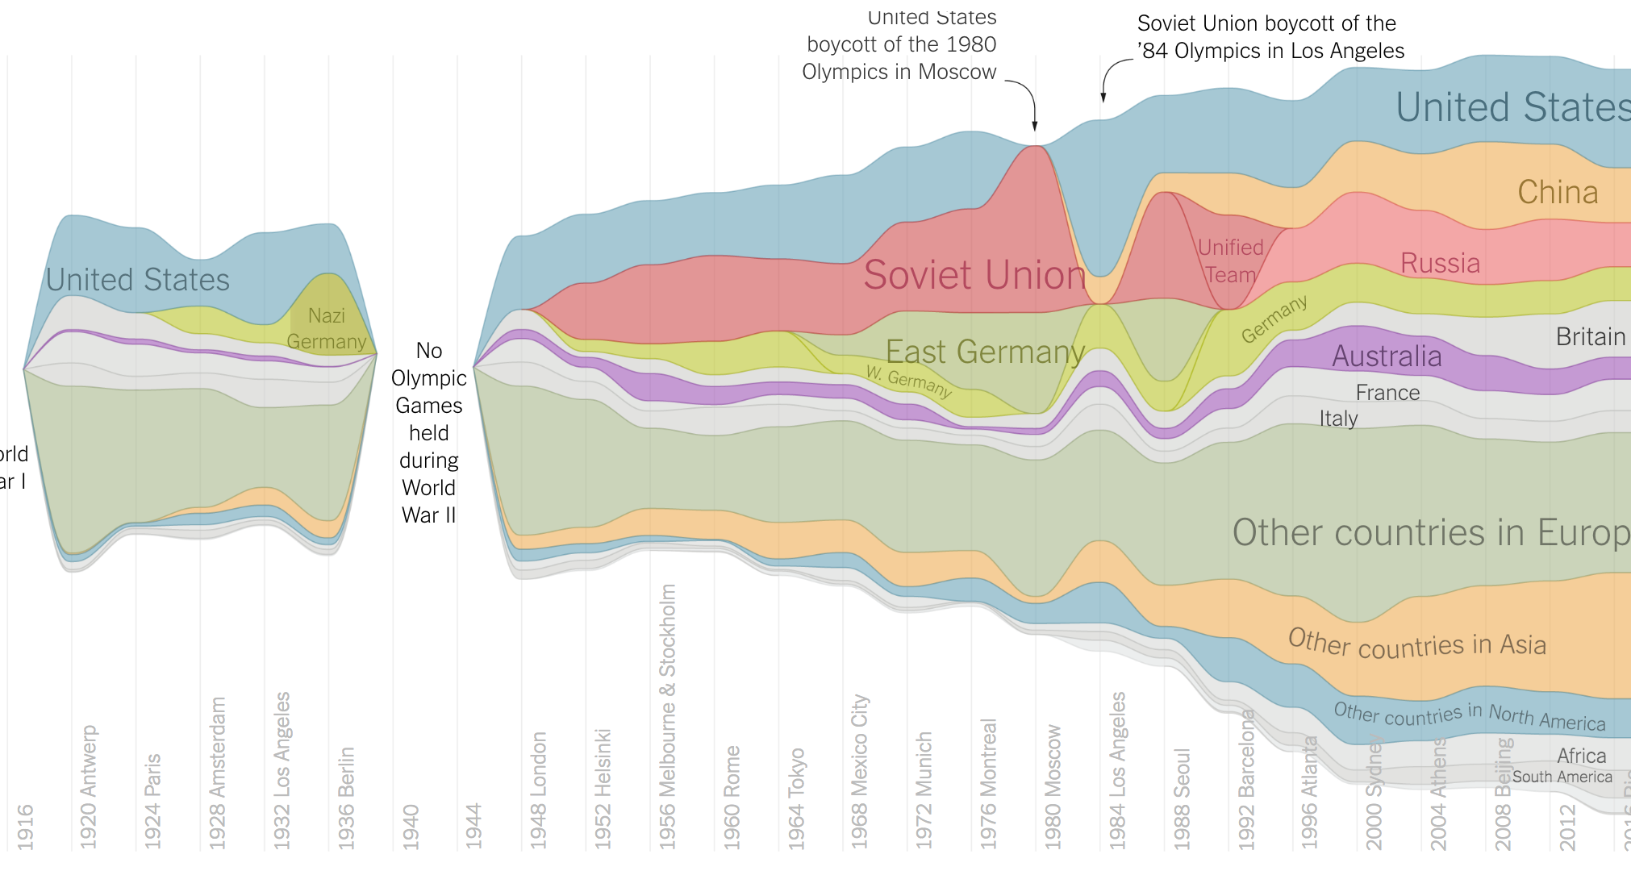
Olympic Medals
<number>
https://www.nytimes.com/interactive/2016/08/08/sports/olympics/history-olympic-dominance-charts.html

Slide 36
Netflix Prize I
Recommender systems: predict a user’s rating of an item
Netflix Prize: $1MM to the first team that beats our in-house engine by 10%
Happened after about three years
Model was never used by Netflix for a variety of reasons
  Out of date (DVDs vs streaming)
  Too complicated / not interpretable
 | Twilight | Wall-E | Twilight II | Furious 7
User 1 | +1 | -1 | +1 | ?
User 2 | +1 | -1 | ? | ?
User 3 | -1 | +1 | -1 | +1
<number>

Slide 37
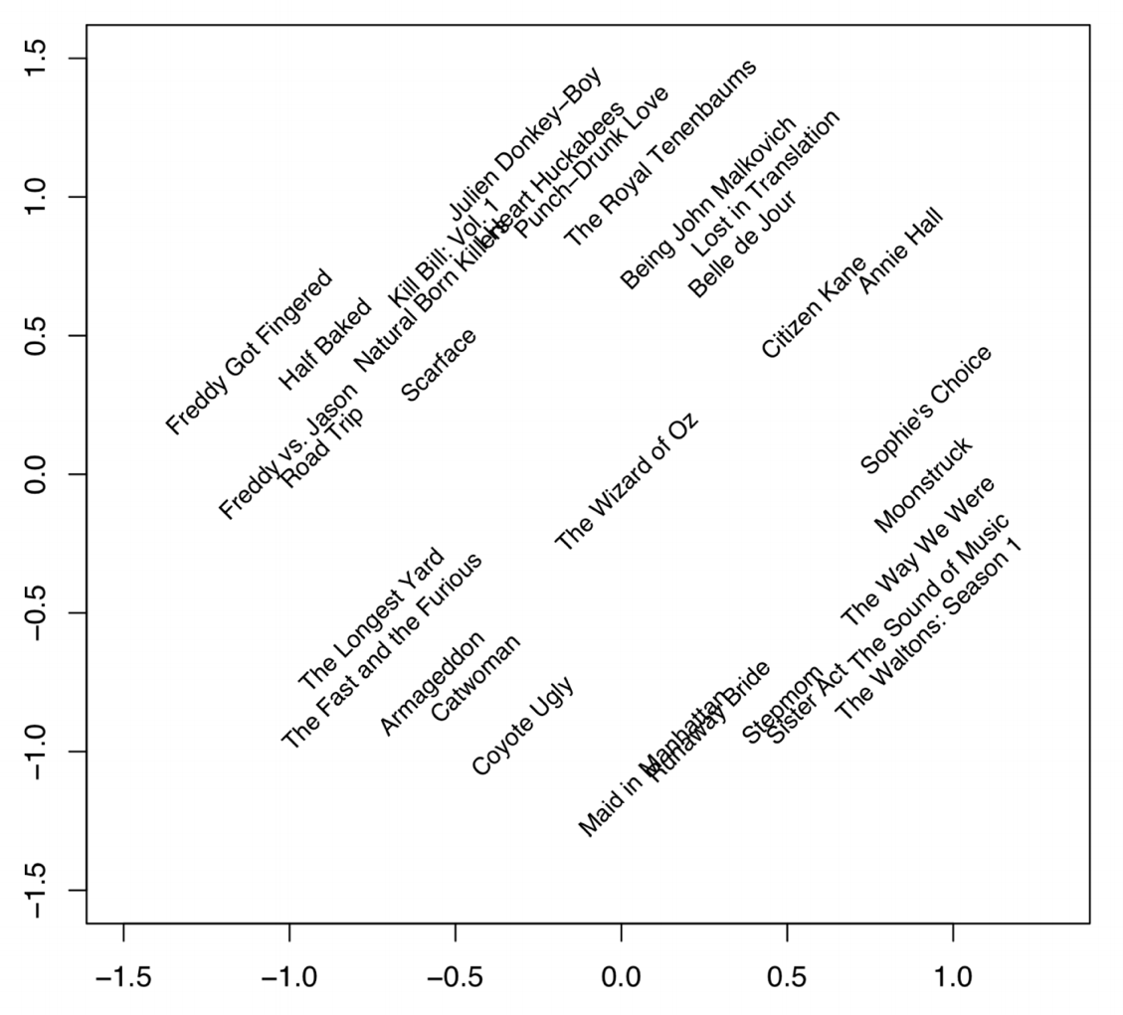
Netflix Prize II
Frat/Gross-Out Comedy
Critically-Acclaimed/Strong Female Lead
Artsy
Latent factors model:
Identify factors with max discrimination between movies
Latent factor 1
BB
<number>
Latent factor 2
Image courtesy of Christopher Volinsky

Slide 38
Netflix Prize III
Netflix initially planned a follow-up competition
In 2007, UT Austin managed to deanonymize portions of the original released (anonymized) Netflix dataset:
????????????
Matched rating against those made publicly on IMDb
Why could this be bad?
2009—2010, four Netflix users filed a class-action lawsuit against Netflix over
<number>

Slide 39
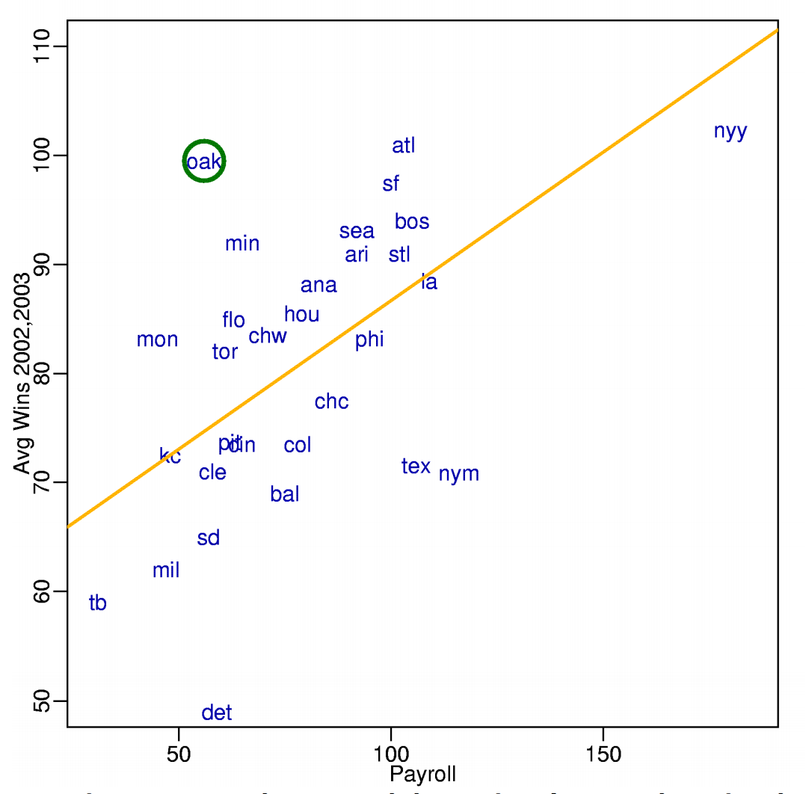
MoneyBall
Baseball teams drafted rookie players primarily based on human scouts’ opinions of their talents
Paul DePodesta, data scientist du jour, convinces the {bad, poor} Oakland Athletics to use a quantitative aka sabermetric approach to hiring
(Spoiler: Red Sox offer Brand a job, he says no, they take a sabermetric approach and win the World Series.)
(Spoiler #2: DePodesta is now GM for the Browns, who are extremely bad right now. We’ll see what happens!)
<number>
Notes:
“Sabermetrics” = “SABR” = “Society for American Baseball Research”
Peter Brand = name of character in the movie, actual name is Paul DePodesta
<number>

Slide 40
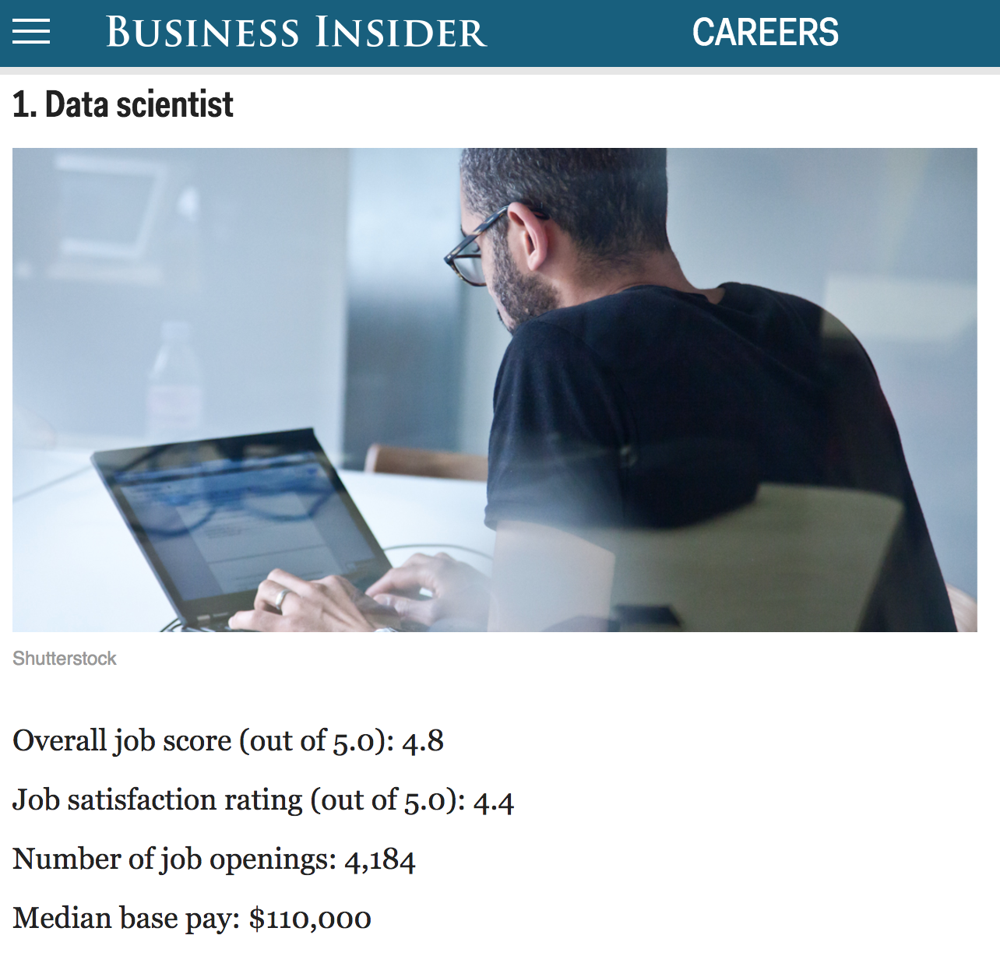
<number>
http://www.businessinsider.com/best-jobs-in-america-in-2017-2017-1/

Slide 41
Wrap-Up For Today
Register on Piazza using your UMD address:
piazza.com/umd/fall2020/cmsc320
Please get in touch with me if you’re unsure of whether or not you’re at the right {programming, math} level for this course:
My guess is that you are!
This is a young class, so we’re quite flexible
Tonight, read about Docker & Jupyter!
Works on *nix, OSX, Windows
https://www.docker.com/
(We’ll post a small project shortly.)
<number>

Slide 42
Next Class:
Scraping Data With Python
<number>
Notes:
<number>

