Slide 1
Introduction to Data Science
John P Dickerson
Lecture #10 – 10/01/2020
Lecture #11 – 10/06/2020
CMSC320
Tuesdays & Thursdays
5:00pm – 6:15pm (… or anytime on the Internet)

Slide 2
Today’s Lecture
Data collection
Data processing
Exploratory analysis
&
Data viz
Analysis, hypothesis testing, & ML
Insight & Policy Decision

Slide 3
Exploratory Data Analysis
Seen so far:
Manipulations that prepare datasets into tidy form
Join tables and compute summaries
Form relationships between different entities
EDA is the last step before Big Time Statistics and ML™:
Want to quickly “get a feel” for the data through summary statistics, visualization, et cetera
Spot nuances like skew, how distributed the data is, trends, how pairs of variables interact, problems
Suggests which Stats/ML assumptions to make and approaches to take

Slide 4
NEXT Week’s lesson
Having a really big sample does not assure you of an accurate result.
It may assure you of a really solid, really bad (inaccurate) result.
Not all randomness is create equal when it comes to random sampling of a population:
Ask why data are missing! MCAR, MAR, MNAR.
Ask how the data were collected.

Slide 5
Today’s lesson: Summary Statistics
Part of descriptive statistics, used to summarize data:
Convey lots of information with extreme simplicity
Descriptive statistics for a variable:
Measures of location: mean, median, mode
Measure of dispersion: variance, standard deviation
Measuring correlation of two variables:
Understanding correlation
Measuring correlation
Scatter plots and regression
Thanks to William Green (NYU Stern IOMS) and Hector Corrada Bravo (UMD)

Slide 6
Measures of Location
These are 30 hours of average defect data on sets of circuit boards. Roughly what is the typical value?
1.45 1.65 1.50 2.25 1.65 1.60 2.30 2.20 2.70 1.70 2.35 1.70 1.90 1.45 1.40 2.60 2.05 1.70 1.05 2.35 1.90 1.55 1.95 1.60 2.05 2.05 1.70 2.30 1.30 2.35
Location and central tendency
There exists a distribution of values
We are interested in the “center” of the distribution
Two measures are the sample mean and the sample median
They look similar, and measure the same thing
They differ systematically (and predictably) when the data are not symmetric
[WG]

Slide 7
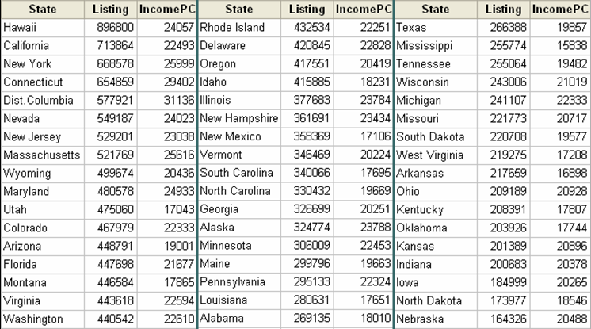
The mean Of aggregate data
Average list price:
1/51 ($898,800 + $713,864 + … + $164,326) = $369,687
[WG]

Slide 8
Averaging Averages?
Hawaii’s average listing = $896,800
Hawaii’s population = 1,275,194
Illinois’ average listing = $377,683
Illinois’ population = 12,763,371
Illinois and Hawaii each get an equal weight of 1/51 = .019607 when the mean is computed.
Looks like Hawaii is getting too much influence …
[WG]

Slide 9
Weighted Average
New average is $409,234 compared to $369,687 without weights, an error of 11%
Sometimes an unequal weighting of the observations is necessary
State population data: http://www.factmonster.com/ipka/A0004986.html

Slide 10
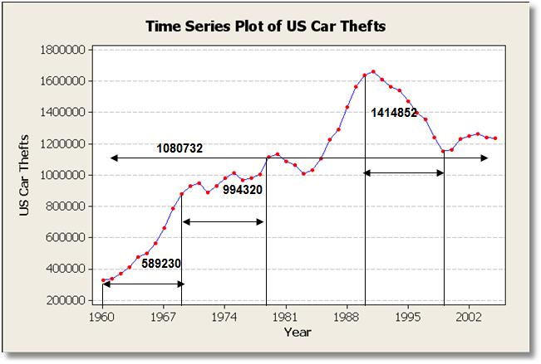
Averages & Time Series
Averaging trending time series is usually not helpful
Mean changes completely depending on time interval
What about periodic time series data ??????????
Ask yourself:
Does the mean over the entire observation period mean anything?
Does it estimate anything meaningful?

Slide 11
The Sample Median
Median:
Sort the data
Take the middle point*
Odd number:
Central observation: Med[1,2,4,6,8,9,17]
Even number:
Midpoint between the two central observations Med[1,2,4,6,8,9,14,17] = (6+8)/2=7
* CMSC351 will show you how to find the median in linear time!

Slide 12
What is the center?
The mean and median measure the central tendency of data
Generally, the center of of a dataset is a point in its range that is close to the data.
Close? Need a distance metric between two points x and x₂
We’ve talked about some already!
Absolute deviation: | x₁ – x₂ |
Squared deviation: (x₁ – x₂)²
We’ll define the center based on these metrics

Slide 13
Dataset for this part
53,940 measurements of diamonds
More info: https://en.wikipedia.org/wiki/Diamond_(gemstone)#Gemological_characteristics

Slide 14
The Mean Revisited
Define a center point μ based on some function of the distance from each data point to that center point
Residual sum of squares (RSS) for a point μ:
So what should our estimate of the “center” of this dataset be, based on the RSS metric?
?????????????

Slide 15
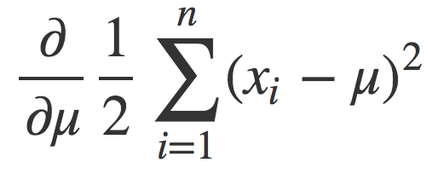
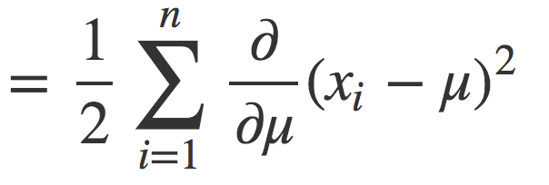
The mean Revisited
Want the point μ that minimizes the RSS ??????????
Find the derivative of RSS and set it to zero, solve for μ!

Slide 16
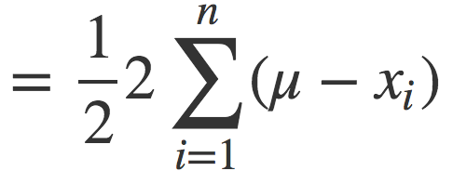
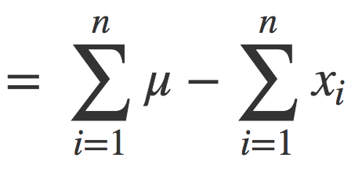
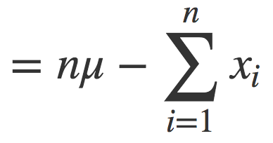
The mean revisited

Slide 17
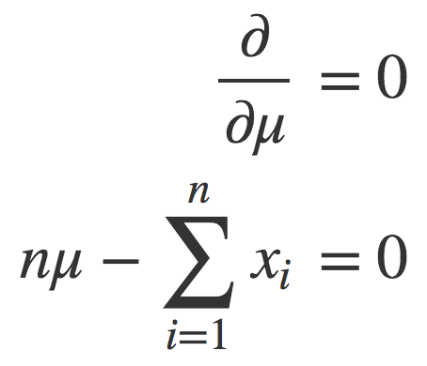
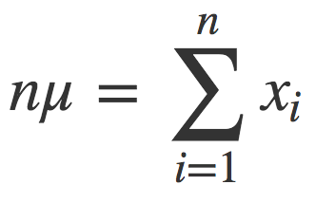
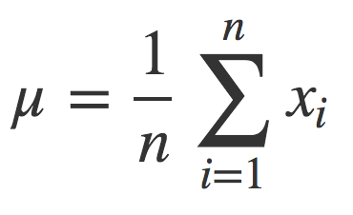
The mean revisited
Set the derivative to zero and solve for μ:
The mean is the point μ that minimizes the RSS for a dataset.

Slide 18
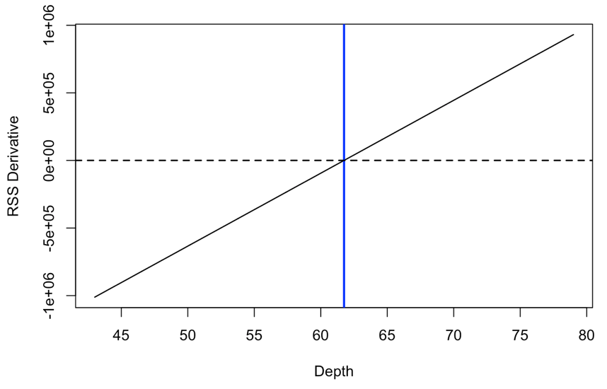
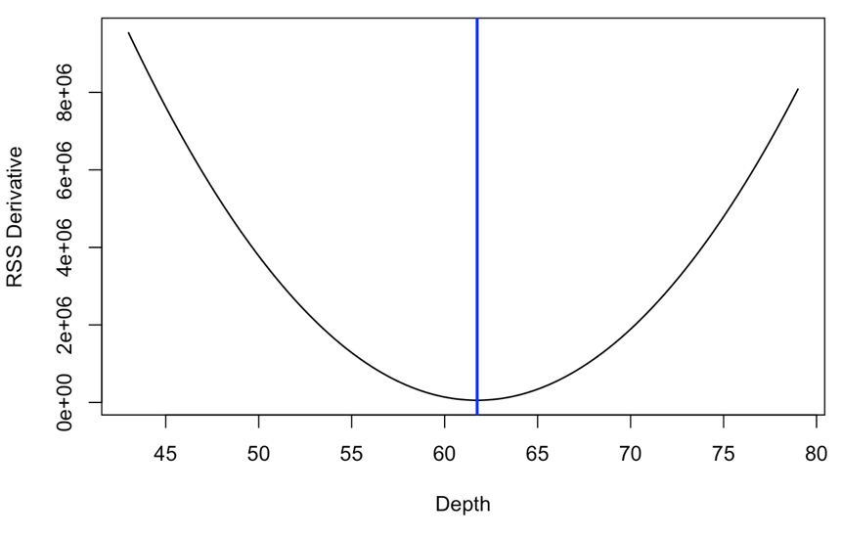
The mean revisited
What about a weighted average ???????
The mean is the point μ that minimizes the RSS for a dataset.

Slide 19
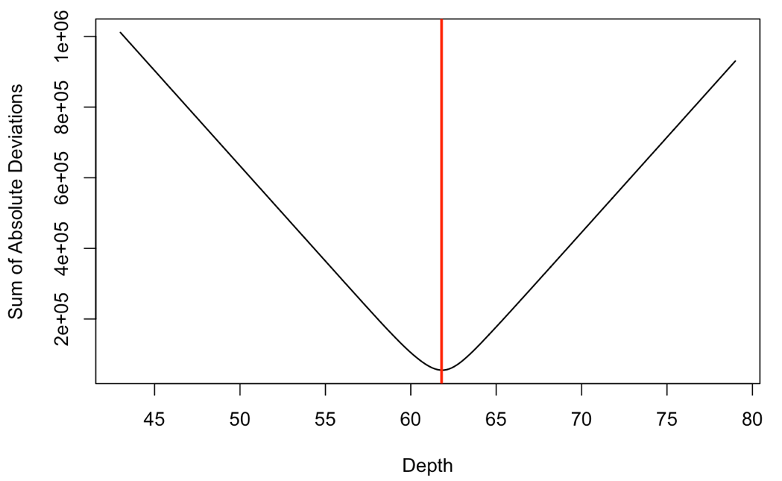
The median revisited
Define a center point m based on some function of the distance from each data point to that center point
The median m minimizes the sum of absolute differences:

Slide 20
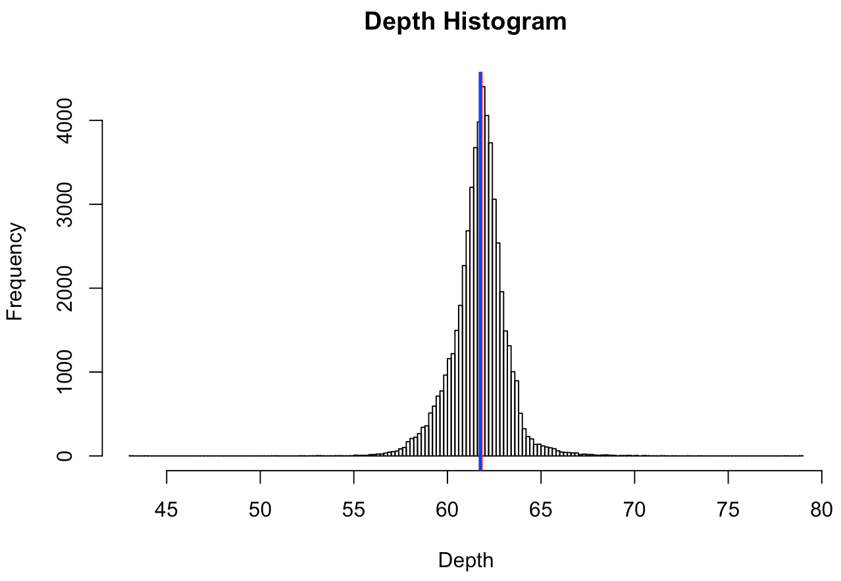
Mean != Median

Slide 21
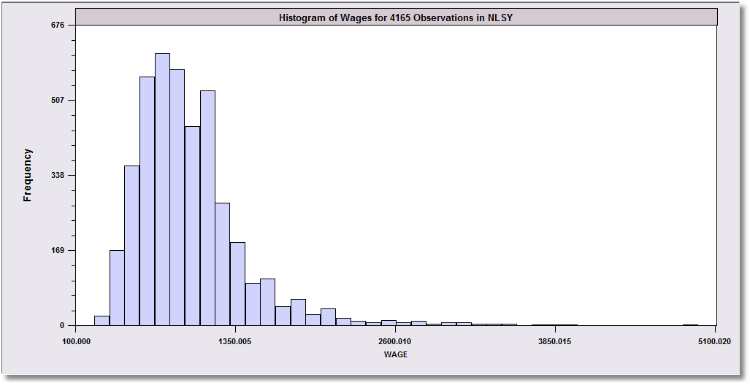
Skewed Data
Monthly Earnings N = 595, Median = 800 Mean = 883
These data are skewed to the right.
Median
Mean
The mean will exceed the median when the distribution is skewed to the right.
Skewness is in the direction of the long tail

Slide 22
SKewness
Extreme observations distort means but not medians.
Outlying observations distort the mean:
Med [1,2,4,6,8,9,17] = 6
Mean[1,2,4,6,8,9,17] = 6.714
Med [1,2,4,6,8,9,17000] = 6 (still)
Mean[1,2,4,6,8,9,17000] = 2432.8 (!)
Typically occurs when there are some outlying observations, such as in cross sections of income or wealth and/or when the sample is not very large.

Slide 23
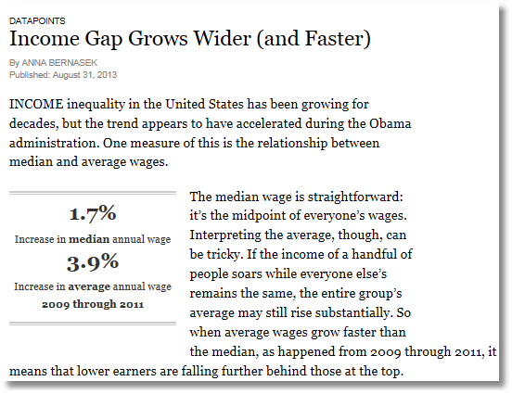

Slide 24
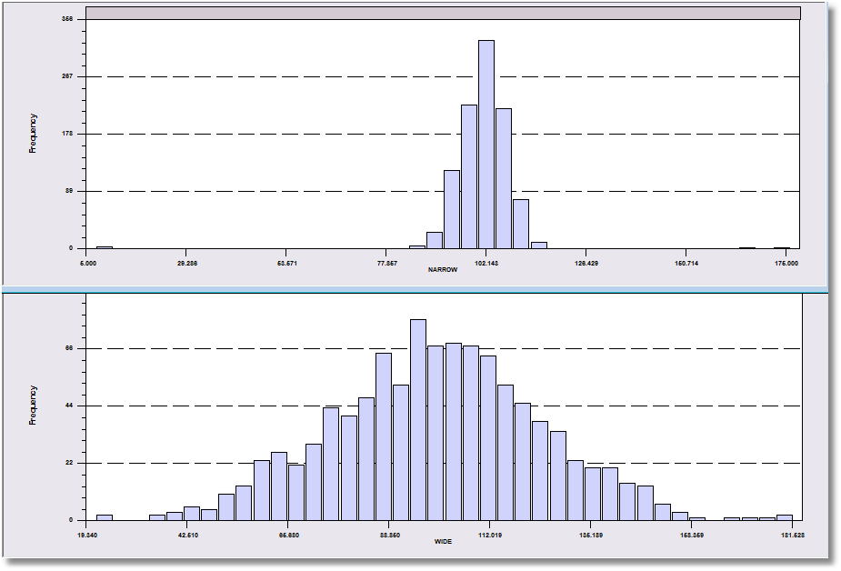
More Information Needed!
Both data sets have a mean of about 100.

Slide 25
Dispersion of the Observations
30 hours of average defect data on sets of circuit boards.
1.45 1.65 1.50 2.25 1.65 1.60 2.30 2.20 2.70 1.70 2.35 1.70 1.90 1.45 1.40 2.60 2.05 1.70 1.05 2.35 1.90 1.55 1.95 1.60 2.05 2.05 1.70 2.30 1.30 2.35
We quantify the variation of the values around the mean.
Note the range is from 1.05 to 2.70. This gives an idea where the data lie.
The mean plus a measure of the variation do the same job.

Slide 26
Range as a Measure of Dispersion
Problems ????????
These two data sets both have 1,000 observations that range from about 10 to about 180.

Slide 27
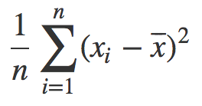
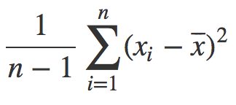
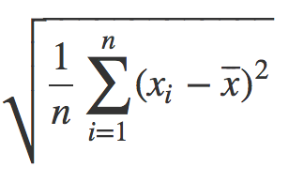
Variance & STDEV: Univariate Measures of dispersion
Variance = s_{X}² =
Standard deviation = s_{X} =
The variance is commonly used statistic for spread
What are the units of the variance ??????????
Standard deviation “fixes this,” can be used as an interpretable unit of measurement
or
Why n-1? http://nebula.deanza.edu/~bloom/math10/m10divideby_nminus1.pdf

Slide 28
Variance, aside: Why divide by n-1?
Remember: we are typically calculating the mean / median / variance / etc of a sample of a population
Want that {mean, median, variance, …} to be an “unbiased” estimate of the true population’s {mean, median, variance, …}
Unbiased? Consider variance …
Look at every possible sample of the population
Compute sample variance of each population
Is the average of those variances equal to the population variance? If so, then this is an “unbiased” estimator.

Slide 29
Variance, aside: Why divide by n-1?
Dividing by n-1 in the sample variance computation leads to an unbiased estimate of the population variance
Intuition. Fix a sample …
Variance measures distribution around a mean
Sampled values are, on average, closer to sample mean than to true population mean
So, we will underestimate the true variance slightly
Using n-1 instead of n makes our variance calculation bigger
This “embiggening” impacts smaller n more than larger n
Larger samples are better estimates of population
If sample is the population, just divide by n …

Slide 30
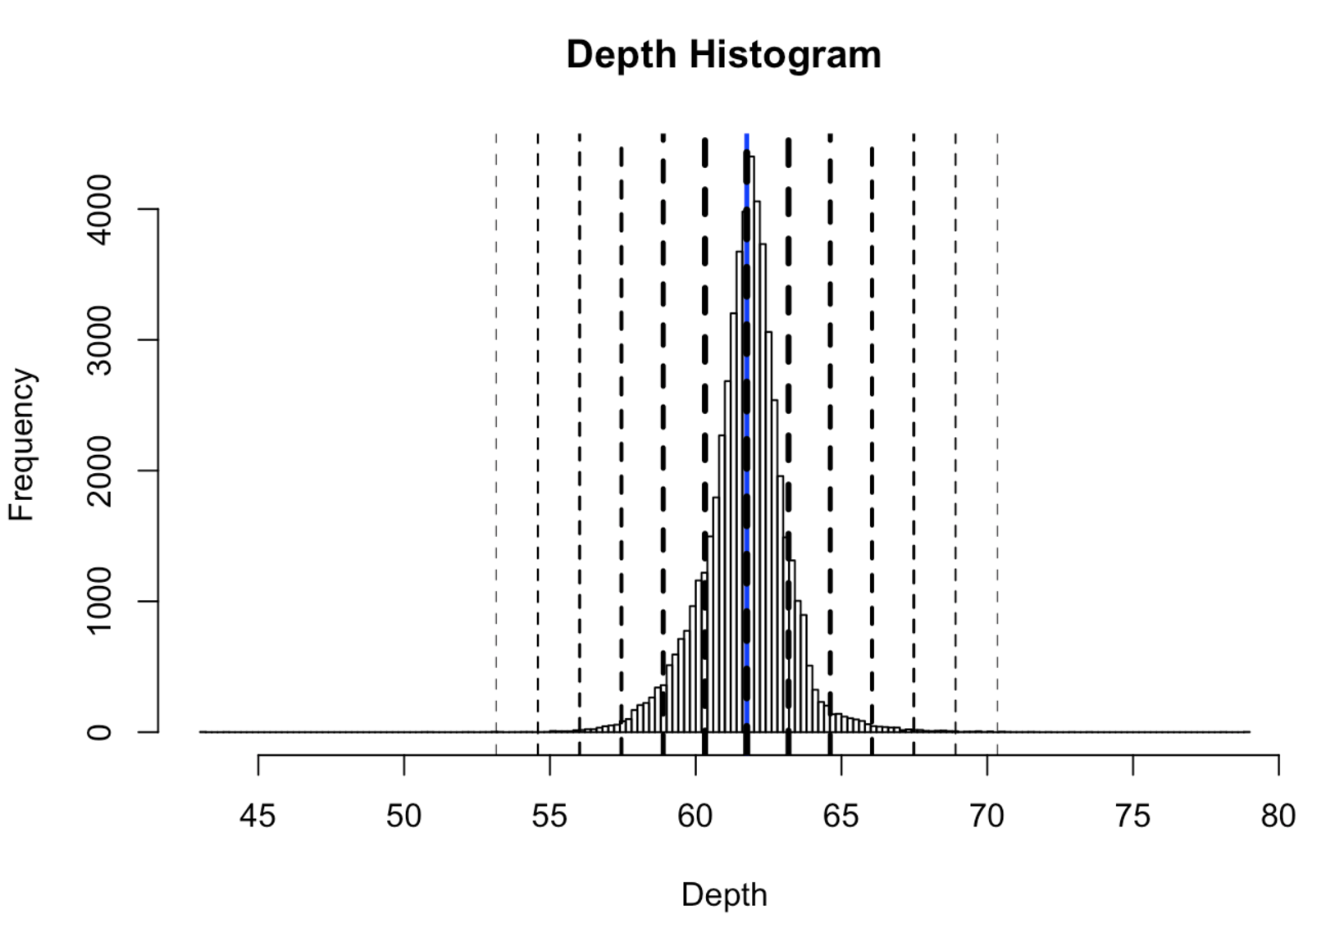

Slide 31
Using “standard deviations from the mean” as a unit
SDs | Proportion | Interpretation
1 | 0.68 | 68% of the data is within ± 1 sds
2 | 0.95 | 95% of the data is within ± 2 sds
3 | 0.9973 | 99.73% of the data is within ± 3 sds
4 | 0.999937 | 99.9937% of the data is within ± 4 sds
5 | 0.9999994 | 99.999943% of the data is within ± 5 sds
6 | 1 | 99.9999998% of the data is within ± 6 sds

Slide 32
Pairs of data Points?

Slide 33
Correlation
Variables Y and X vary together
Causality vs. correlation: Does movement in X “cause” movement in Y in some metaphysical sense?
Correlation
Simultaneous movement through a statistical relationship
Simultaneous variation “induced” by the variation of a common third effect

Slide 34
House Prices & Per Capita Income

Slide 35
Scatter Plot Suggests Positive Correlation

Slide 36
Linear Regression Measures Correlation
Regression Line: Listing = a + b IncomePC

Slide 37
Correlation Is Not Causation
Price and income seem to be positively correlated.
Does a rise in income cause a rise in gas prices ??????????????
US gasoline prices, 1953-2004, plotted against per-capita US income

Slide 38
A Hidden Relationship
Not positively “related” to each other; both positively related to “time.”

Slide 39
“Related” ...?
Want to capture: some variable X varies in the same direction and at the same scale as some other variable Y
What happens if:
X varies in the opposite direction as Y ????????
X varies in the same direction as Y ????????
What are the units of the covariance ????????
Pearson’s correlation coefficient is unitless in [-1,+1]:

Slide 40
Correlation
r_{Income,Listing} = +0.591

Slide 41
Correlations
r = 0.0
r = +1.0
r = +0.5

Slide 42
Correlation is not causation!!!
 | 2000 | 2001 | 2002 | 2003 | 2004 | 2005 | 2006 | 2007 | 2008 | 2009
Divorce rate in Maine Divorces per 1000 people (US Census) | 5 | 4.7 | 4.6 | 4.4 | 4.3 | 4.1 | 4.2 | 4.2 | 4.2 | 4.1
Per capita consumption of margarine (US) Pounds (USDA) | 8.2 | 7 | 6.5 | 5.3 | 5.2 | 4 | 4.6 | 4.5 | 4.2 | 3.7
r=0.993
?????????
http://tylervigen.com/spurious-correlations

Slide 43
Just to drive the point home …

Slide 44
Transformations

Slide 45
Transformations
So, you’ve figured out that your data are:
Skewed
Have vastly different ranges across datasets and/or different units
What do you do?
Transform the variables to:
ease the validity and interpretation of data analyses
change or ease the type of Stat/ML models you can use

Slide 46
Standardization
Transforming the variable to a comparable metric
known unit
known mean
known standard deviation
known range
Three ways of standardizing:
P-standardization (percentile scores)
Z-standardization (z-scores)
D-standardization (dichotomize a variable)
Slides adapted from Maarten Buis

Slide 47
When you should always standardize
When averaging multiple variables, e.g. when creating a socioeconomic status variable out of income and education.
When comparing the effects of variables with unequal units, e.g. does age or education have a larger effect on income?
Slides adapted from Maarten Buis

Slide 48
P-Standardization
Every observation is assigned a number between 0 and 100, indicating the percentage of observation beneath it.
Can be read from the cumulative distribution
In case of knots: assign midpoints
The median, quartiles, quintiles, and deciles are special cases of P-scores.
Slides adapted from Maarten Buis

Slide 49
Slides adapted from Maarten Buis

Slide 50
P-standardization
Turns the variable into a ranking, i.e. it turns the variable into a ordinal variable.
It is a non-linear transformation: relative distances change
Results in a fixed mean, range, and standard deviation; M=50, SD=28.6, This can change slightly due to knots
A histogram of a P-standardized variable approximates a uniform distribution
Slides adapted from Maarten Buis

Slide 51
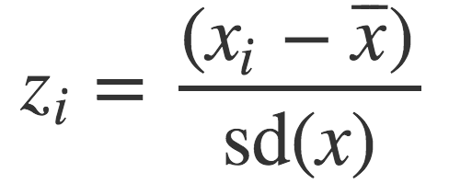
Centering And Scaling
Transform your data into a unitless scale
Put data into “standard deviations from the mean” units
This is called standardizing a variable, into standard units
Given data points x = x₁, x₂, ..., x_{n}:
Translates x into a scaled and centered variable z
What is the mean of z ??????????
What is the standard deviation of z ??????????
Notes:
Mean of z = 0
Stdev of z = 1

Slide 52
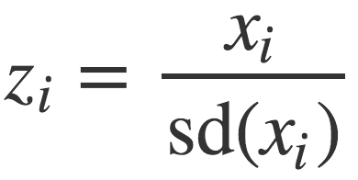
Centering or Scaling
Maybe you just want to center the data:
What is the mean of z ??????????
What is the standard deviation of z ??????????
Maybe you just want to scale the data:
What is the mean of z ??????????
What is the standard deviation of z ??????????

Slide 53
Discrete to continuous variables
Some models only work on continuous numeric data
Convert a binary variable to a number ???????????
health_insurance = {“yes”, “no”} → {1, 0}
Why not {-1, +1} or {-10, +14}?
0/1 encoding lets us say things like “if a person has healthcare then their income increases by $X.”
Might need {-1,+1} for certain ML algorithms (e.g., SVM)

Slide 54
Discrete to continuous variables
What about non-binary variables?
My main transportation is a {BMW, Bicycle, Hovercraft}
One option: { BMW → 1, Bicycle → 2, Hovercraft → 3 }
Problems ??????????
One-hot encoding: convert a categorical variable with N values into a N-bit vector:
BMW → [1, 0, 0]; Bicycle → [0, 1, 0]; Hovercraft → [0, 0, 1]
# Converts dtype=category to one-hot-encoded cols
cols = [‘my_transportation’]
df = df.get_dummies( columns = cols )

Slide 55
Continuous to discrete variables
Do doctors prescribe a certain medication to older kids more often? Is there a difference in wage based on age?
Pick a discrete set of bins, then put values into the bins
Equal-length bins:
Bins have an equal-length range and skewed membership
Good/Bad ????????
Equal-sized bins:
Bins have variable-length ranges but equal membership
Good/Bad ????????

Slide 56
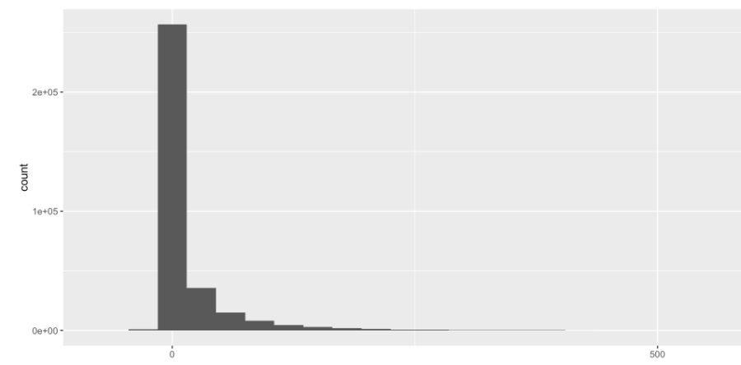
Skewed Data
Skewed data often arises in multiplicative processes:
Some points float around 1, but one unlucky draw → 0
Logarithmic transforms reduce skew:
If values are all positive, apply log₂ transform
If some values are negative:
Shift all values so they are positive, apply log₂
Signed log: sign(x) * log₂( |x| + 1)

Slide 57
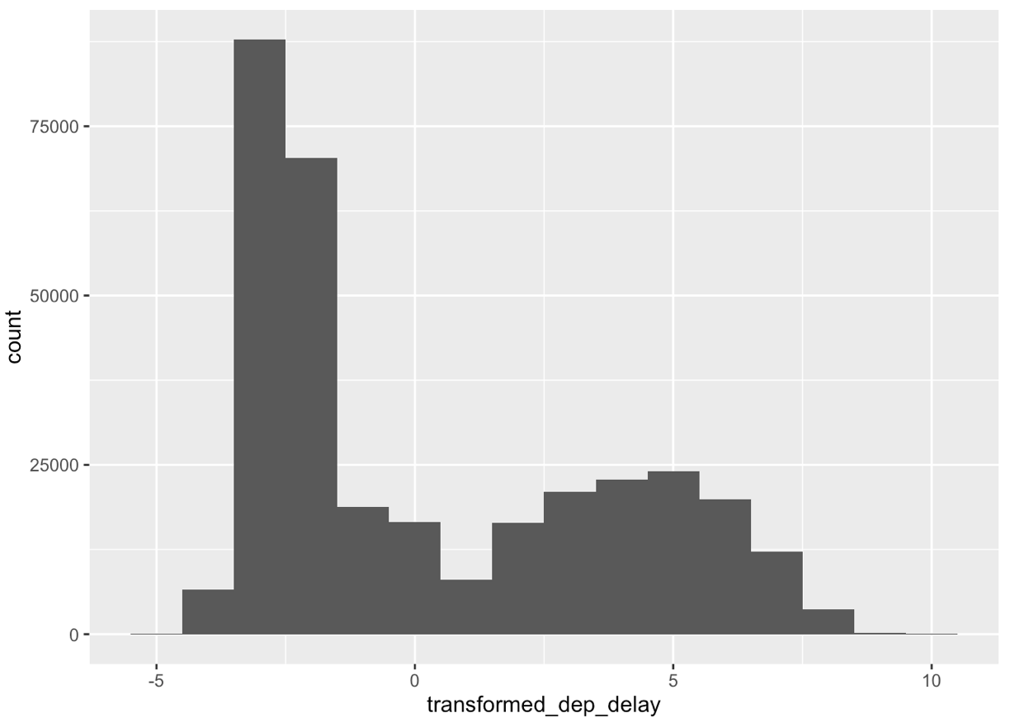
Skewed Data
log₂ transform on airline takeoff delays

