Slide 1
Introduction to Data Science
John P Dickerson
Lecture #2 – 09/03/2020
CMSC320
Tuesdays & Thursdays
5:00pm – 6:15pm (… or anytime on the Internet)

Slide 2
Announcements
Register on Piazza: piazza.com/umd/fall2020/cmsc320
194 have registered already
56 have not registered yet
If you were on Piazza, you’d know …
Project 0 is out! It is “due” next Tuesday evening.
Link: https://github.com/cmsc320/fall2020/tree/master/project0
We’ve also linked some reading for the week!
First quiz is due Tuesday at noon.
(Quiz is up on ELMS now.)

Slide 3
(A few) Data Science Success Stories & Cautionary Tales

Slide 4
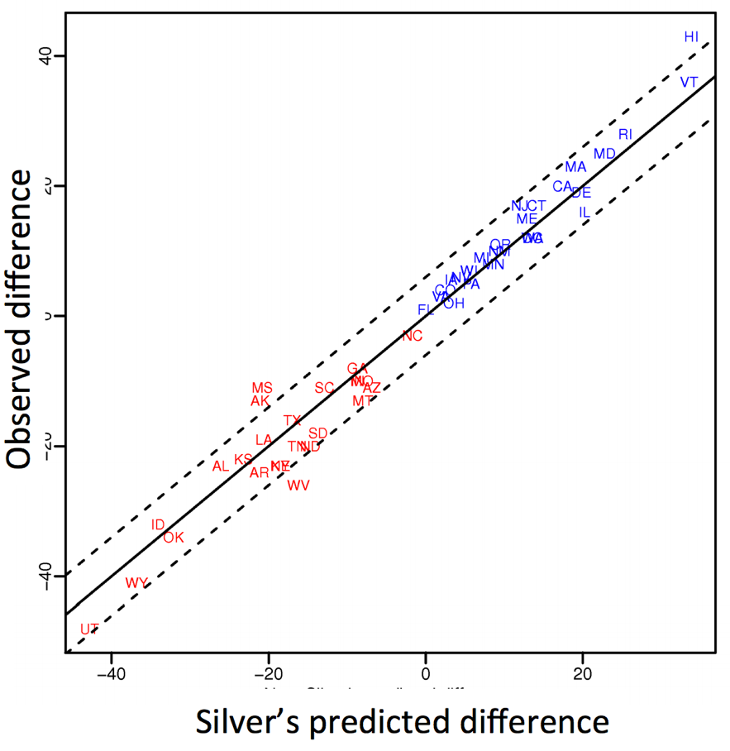
Polling: 2008 & 2012
Nate Silver uses a simple idea – taking a principled approach to aggregating polling instead of relying on punditry – and:
Predicts 49/50 states in 2008
Predicts 50/50 states in 2012
(He is also a great case study in creating a brand.)
https://hbr.org/2012/11/how-nate-silver-won-the-2012-p
Democrat (+) or Republican (-) in 2012

Slide 5
Polling: 2016
HuffPo: “He may end up being right, but he’s just guessing. A “trend line adjustment” is merely political punditry dressed up as sophisticated mathematical modeling.”
538: Offers quantitative reasoning for re-/under-weighting older polls, & changing as election approaches
http://www.huffingtonpost.com/entry/nate-silver-election-forecast_us_581e1c33e4b0d9ce6fbc6f7f
https://fivethirtyeight.com/features/a-users-guide-to-fivethirtyeights-2016-general-election-forecast/

Slide 6
Ad Targeting
Pregnancy is an expensive & habit-forming time
Thus, valuable to consumer-facing firms
2012:
Target identifies 25 products and subsets thereof that are commonly bought in early pregnancy
Uses purchase history of patrons to predict pregnancy, targets advertising for post-natal products (cribs, etc)
Good: increased revenue
Bad: this can expose pregnancies – as famously happened in Minneapolis to a high schooler
http://www.businessinsider.com/the-incredible-story-of-how-target-exposed-a-teen-girls-pregnancy-2012-2

Slide 7
Automated decisions of consequence
[Sweeney 2013, Miller 2015, Byrnes 2016,
Rudin 2013, Barry-Jester et al. 2015]
Hiring
Lending
Policing/
sentencing
Search for minority names →
ads for DUI/arrest records
Female cookies →
less freq. shown professional job opening ads

Slide 8
“… a lot remains unknown about how big data-driven decisions may or may not use factors that are proxies for race, sex, or other traits that U.S. laws generally prohibit from being used in a wide range of commercial decisions … What can be done to make sure these products and services–and the companies that use them treat consumers fairly and ethically?”
- FTC Commissioner Julie Brill [2015]

Slide 9
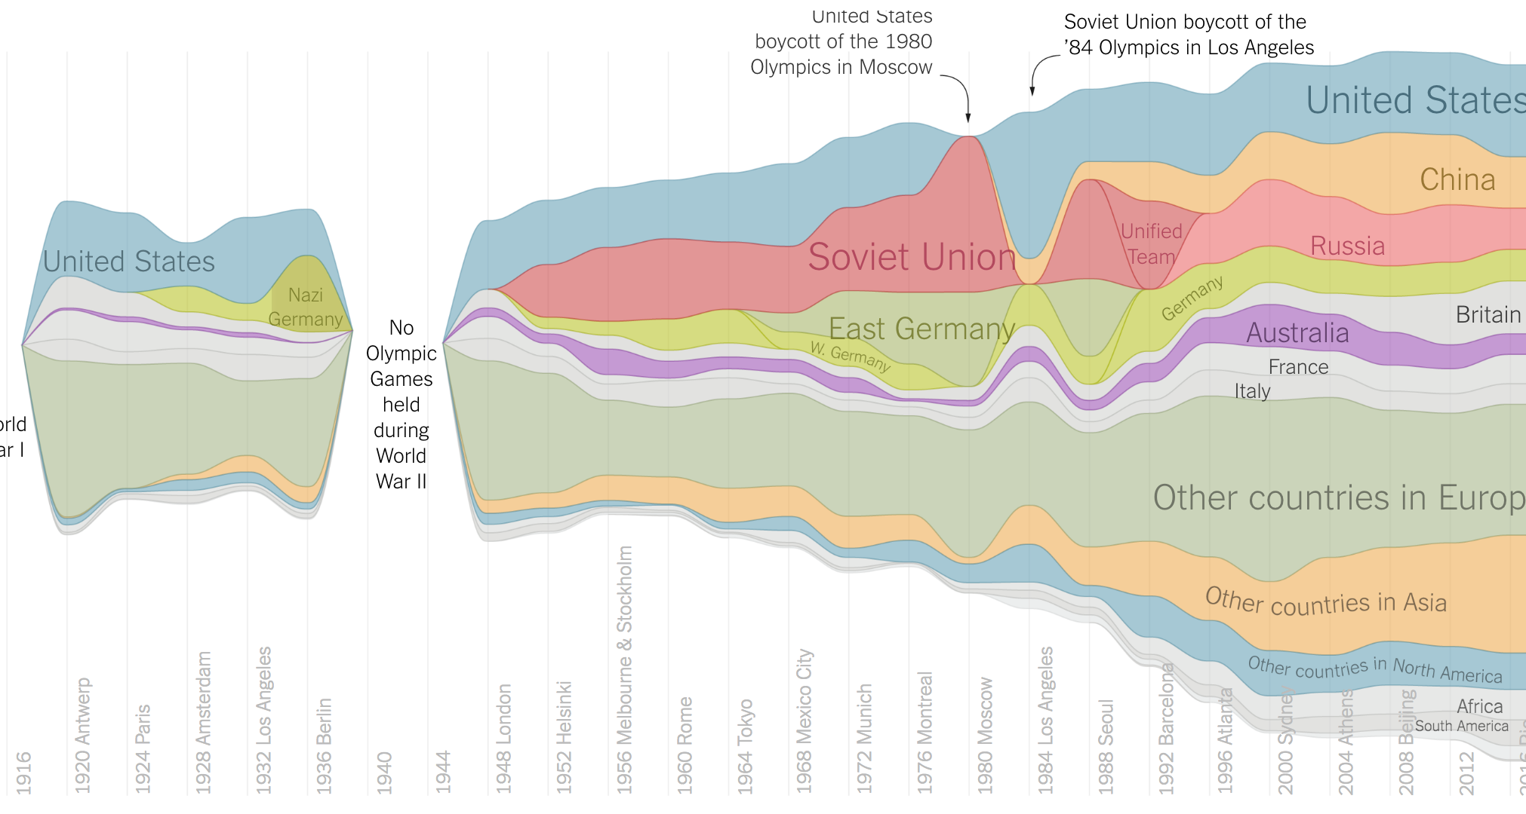
Olympic Medals
https://www.nytimes.com/interactive/2016/08/08/sports/olympics/history-olympic-dominance-charts.html

Slide 10
Netflix Prize I
Recommender systems: predict a user’s rating of an item
Netflix Prize: $1MM to the first team that beats our in-house engine by 10%
Happened after about three years
Model was never used by Netflix for a variety of reasons
Out of date (DVDs vs streaming)
Too complicated / not interpretable
 | Twilight | Wall-E | Twilight II | Furious 7
User 1 | +1 | -1 | +1 | ?
User 2 | +1 | -1 | ? | ?
User 3 | -1 | +1 | -1 | +1

Slide 11
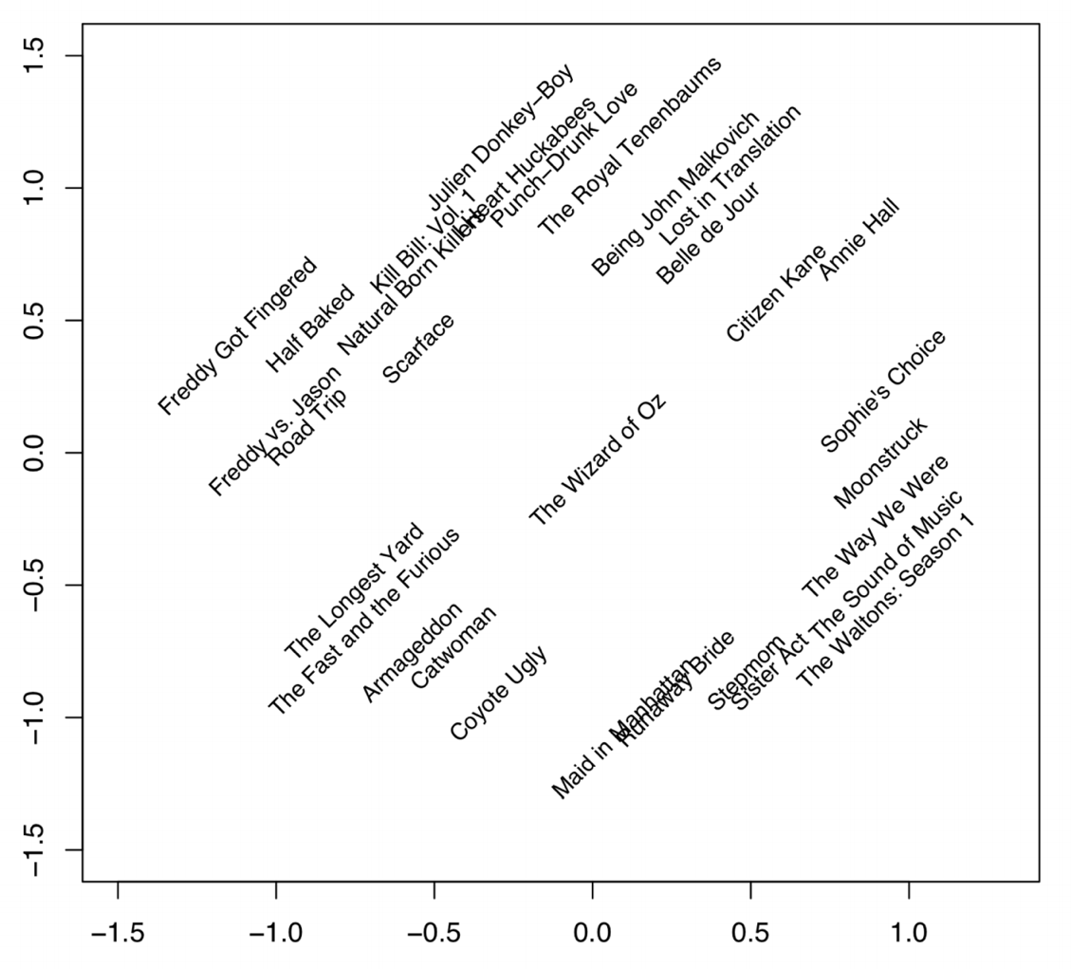
Netflix Prize II
Frat/Gross-Out Comedy
Critically-Acclaimed/Strong Female Lead
Artsy
Latent factors model:
Identify factors with max discrimination between movies
Latent factor 1
BB
Latent factor 2
Image courtesy of Christopher Volinsky

Slide 12
Netflix Prize III
Netflix initially planned a follow-up competition
In 2007, UT Austin managed to deanonymize portions of the original released (anonymized) Netflix dataset:
????????????
Matched rating against those made publicly on IMDb
Why could this be bad?
2009—2010, four Netflix users filed a class-action lawsuit against Netflix over

Slide 13
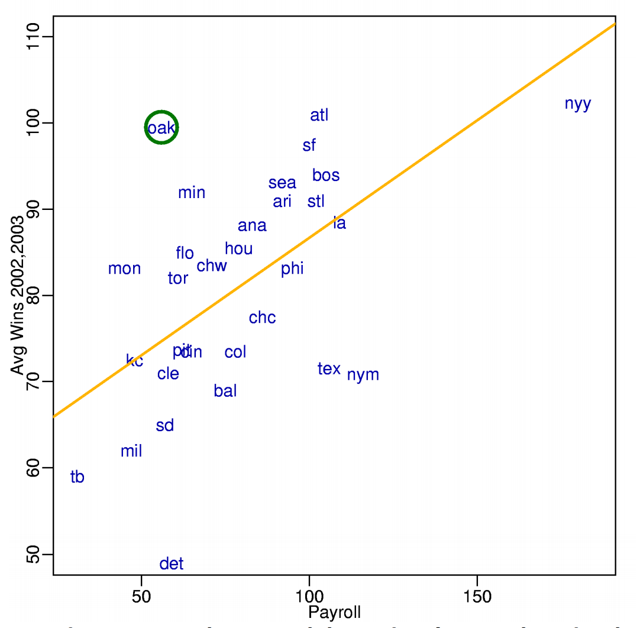
MoneyBall
Baseball teams drafted rookie players primarily based on human scouts’ opinions of their talents
Paul DePodesta, data scientist du jour, convinces the {bad, poor} Oakland Athletics to use a quantitative aka sabermetric approach to hiring
(Spoiler: Red Sox offer Brand a job, he says no, they take a sabermetric approach and win the World Series.)
(Spoiler #2: DePodesta is now GM for the Browns, who are extremely bad right now. We’ll see what happens!)
Notes:
“Sabermetrics” = “SABR” = “Society for American Baseball Research”
Peter Brand = name of character in the movie, actual name is Paul DePodesta

Slide 14
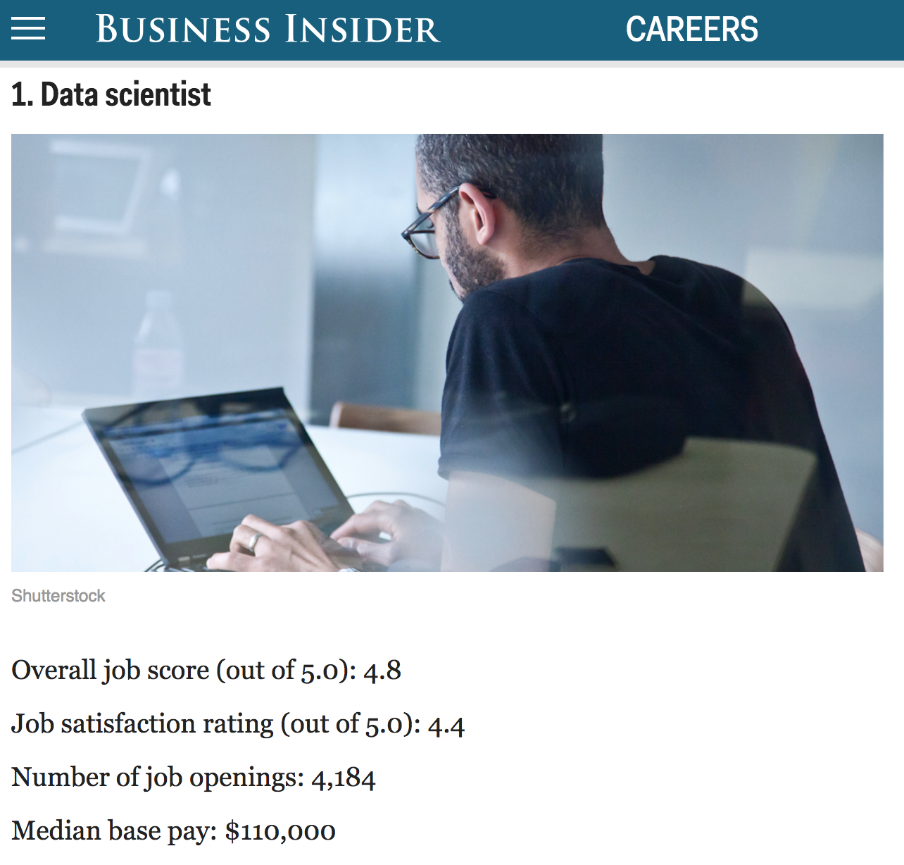
http://www.businessinsider.com/best-jobs-in-america-in-2017-2017-1/

Slide 15
Up Next … Scraping Data With Python

Slide 16
The Data Lifecycle
Data collection
Data processing
Exploratory analysis
&
Data viz
Analysis, hypothesis testing, & ML
Insight & Policy Decision

Slide 17
(The Rest of) Today’s Lecture
Data collection
Data processing
Exploratory analysis
&
Data viz
Analysis, hypothesis testing, & ML
Insight & Policy Decision

Slide 18
But first, snakes!
Python is an interpreted, dynamically-typed, high-level, garbage-collected, object-oriented-functional-imperative, and widely used scripting language.
Interpreted: instructions executed without being compiled into (virtual) machine instructions*
Dynamically-typed: verifies type safety at runtime
High-level: abstracted away from the raw metal and kernel
Garbage-collected: memory management is automated
OOFI: you can do bits of OO, F, and I programming
Not the point of this class!
Python is fast (developer time), intuitive, and used in industry!
*you can compile Python source, but it’s not required

Slide 19
The Zen of Python
Beautiful is better than ugly.
Explicit is better than implicit.
Simple is better than complex.
Complex is better than complicated.
Flat is better than nested.
Sparse is better than dense.
Readability counts.
Special cases aren't special enough to break the rules …
… although practicality beats purity.
Errors should never pass silently …
… unless explicitly silenced.
Thanks: SDSMT ACM/LUG

Slide 20
Literate Programming
Literate code contains in one document:
the source code;
text explanation of the code; and
the end result of running the code.
Basic idea: present code in the order that logic and flow of human thoughts demand, not the machine-needed ordering
Necessary for data science!
Many choices made need textual explanation, ditto results.
Stuff you’ll be using in Project 0 (and beyond)!

Slide 21
Jupyter Project
Started as iPython Notebooks, a web-based frontend to the iPython Shell
Notebook functionality separated out a few years ago
Now supports over 40 languages/kernels
Notebooks can be shared easily
Can leverage big data tools like Spark
Apache Zeppelin:
https://www.linkedin.com/pulse/comprehensive-comparison-jupyter-vs-zeppelin-hoc-q-phan-mba-
Several others including RStudio (specific to R)

Slide 22
10-minute Python primer
Define a function:
Python is whitespace-delimited
Define a function that returns a tuple:
def my_func(x, y):
if x > y:
return x
else:
return y
def my_func(x, y):
return (x-1, y+2)
(a, b) = my_func(1, 2)
a = 0; b = 4

Slide 23
Useful Built-in Functions: Counting and Iterating
len: returns the number of items of an enumerable object
range: returns an iterable object
enumerate: returns iterable tuple (index, element) of a list
https://docs.python.org/3/library/functions.html
len( [‘c’, ‘m’, ‘s’, ‘c’, 3, 2, 0] )
7
list( range(10) )
[0, 1, 2, 3, 4, 5, 6, 7, 8, 9]
enumerate( [“311”, “320”, “330”] )
[(0, “311”), (1, “320”), (2, “330”)]
Notes:
do demo

Slide 24
Useful Built-In Functions: Map and Filter
map: apply a function to a sequence or iterable
filter: returns a list* of elements for which a predicate is true
We’ll go over in much greater depth with pandas/numpy.
arr = [1, 2, 3, 4, 5]
map(lambda x: x**2, arr)
[1, 4, 9, 16, 25]
arr = [1, 2, 3, 4, 5, 6, 7]
filter(lambda x: x % 2 == 0, arr)
[2, 4, 6]
*in Python 3, returns Iterable

Slide 25
Pythonic Programming
Basic iteration over an array in Java:
Direct translation into Python:
A more “Pythonic” way of iterating:
int[] arr = new int[10];
for(int idx=0; idx<arr.length; ++idx) {
System.out.println( arr[idx] );
}
idx = 0
while idx < len(arr):
print( arr[idx] ); idx += 1
for element in arr:
print( element )

Slide 26
List comprehensions
Construct sets like a mathematician!
P = { 1, 2, 4, 8, 16, …, 2¹⁶ }
E = { x | x in ℕ and x is odd and x < 1000 }
Construct lists like a mathematician who codes!
Very similar to map, but:
You’ll see these way more than map in the wild
Many people consider map/filter not “pythonic”
They can perform differently (map is “lazier”)
P = [ 2**x for x in range(17) ]
E = [ x for x in range(1000) if x % 2 != 0 ]

Slide 27
Exceptions
Syntactically correct statement throws an exception:
tweepy (Python Twitter API) returns “Rate limit exceeded”
sqlite (a file-based database) returns IntegrityError
print('Python', python_version())
try:
cause_a_NameError
except NameError as err:
print(err, '-> some extra text')

Slide 28
Python 2 vs 3
Python 3 is intentionally backwards incompatible
(But not that incompatible)
Biggest changes that matter for us:
print “statement” → print(“function”)
1/2 = 0 → 1/2 = 0.5 and 1//2 = 0
ASCII str default → default Unicode
Namespace ambiguity fixed:
i = 1
[i for i in range(5)]
print(i) # ????????
Notes:
Prints “4” in Python 2 and “1” (i.e., unchanged because the list comprehension scope is dead) in Python 3.

Slide 29
To any Curmudgeons …
If you’re going to use Python 2 anyway, use the _future_ module:
Python 3 introduces features that will throw runtime errors in Python 2 (e.g., with statements)
_future_ module incrementally brings 3 functionality into 2
https://docs.python.org/2/library/__future__.html
from _future_ import division
from _future_ import print_function
from _future_ import please_just_use_python_3

Slide 30
So, How does Import Work?
Python code is stored in module – simply put, a file full of Python code
A package is a directory (tree) full of modules that also contains a file called __init.py__
Packages let you structure Python’s module namespace
E.g., X.Y is a submodule Y in a package named X
For one module to gain access to code in another module, it must import it

Slide 31
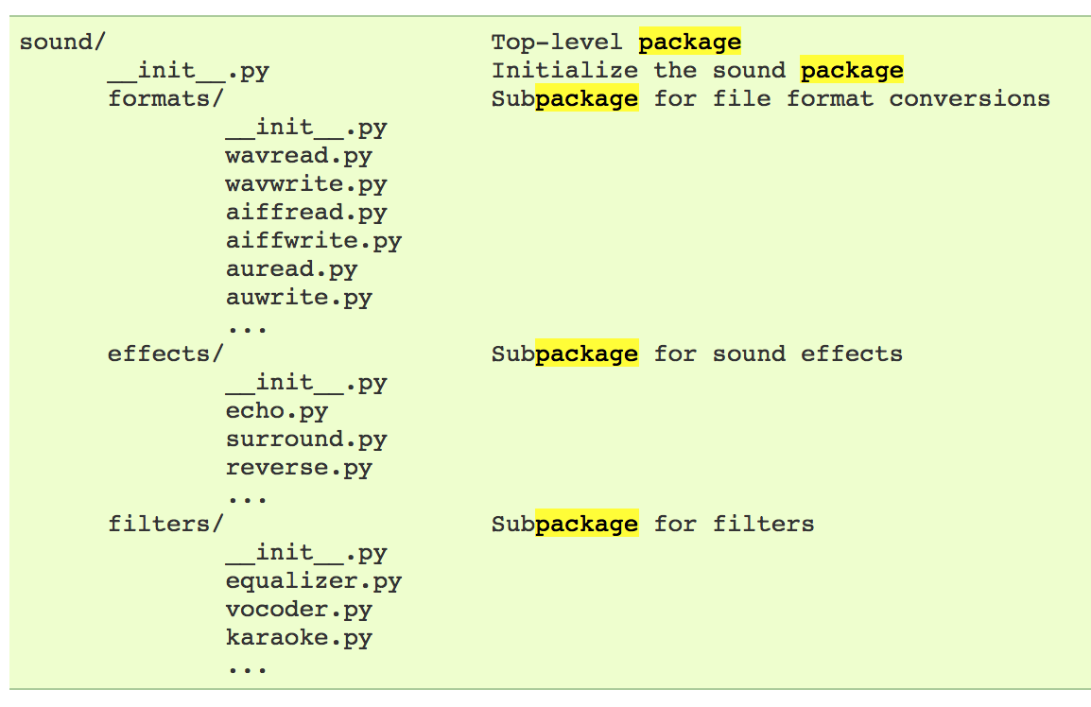
Example
# Load (sub)module sound.effects.echo
import sound.effects.echo
# Must use full name to reference echo functions
sound.effects.echo.echofilter(input, output, delay=0.7)
https://docs.python.org/2/tutorial/modules.html

Slide 32
Example
# Load (sub)module sound.effects.echo
import sound.effects.echo
# Must use full name to reference echo functions
sound.effects.echo.echofilter(input, output, delay=0.7)
# Load (sub)module sound.effects.echo
from sound.effects import echo
# No longer need the package prefix for functions in echo
echo.echofilter(input, output, delay=0.7)
# Load a specific function directly
from sound.effects.echo import echofilter
# Can now use that function with no prefix
echofilter(input, output, delay=0.7)
https://docs.python.org/2/tutorial/modules.html

Slide 33
Python vS R (For Data Scientists)
There is no right answer here!
Python is a “full” programming language – easier to integrate with systems in the field
R has a more mature set of pure stats libraries …
… but Python is catching up quickly …
… and is already ahead specifically for ML.
You will see Python more in the tech industry.

Slide 34
Extra resources
Plenty of tutorials on the web:
https://www.learnpython.org/
Work through Project 0, which will take you through some baby steps with Python and the Pandas library:
(We’ll also post some more readings soon.)
Come (virtually!) hang out at office hours:
All office hours will be on the website/Piazza by early next week.
Will have coverage MTWThF.

Slide 36
Today’s Lecture
Data collection
Data processing
Exploratory analysis
&
Data viz
Analysis, hypothesis testing, & ML
Insight & Policy Decision
with
Thanks: Zico Kolter’s 15-388, Amol Deshpande, Nick Mattei

Slide 37
What is This “data”?

Slide 38
Tabular Data
Quick teaser. We’ll go into greater depth when discussing tidy data.
Data is an abstraction of some real world entity.
Also called: instance, example, record, object, case, individual.
Each of these entities is described by a set of features.
Sometimes called variables, features, attributes, …
Can be processed into an n (number of entities) by m (number of attributes) matrix.
Result of merging & processing different records!
Picking the data that goes into this table has both technical and ethical concerns (recall: Target, Netflix, AOL examples)
ID | Title | Author | Year | Cover | Edition | Price
1 | Emma | Austen | 1815 | Paper | 20th | $5.75
2 | Dracula | Stoker | 1897 | Hard | 15th | $12.00
3 | Ivanhoe | Scott | 1820 | Hard | 8th | $25.00
4 | Kidnapped | Stevenson | 1886 | Paper | 11th | $5.00

Slide 39
Classical Statistical View of Data
There are four classical types of data
Data Types
Categorical
Numerical
Interval
Ratio
Nominal
Ordinal

Slide 40
Categorical Data: Takes a Value From a Finite Set
Nominal (aka Categorical) Data:
Values have names: describe the categories, classes, or states of things
Marital status, drink type, or some binary attribute
Cannot compare easily, thus cannot naturally order them
Ordinal Data:
Values have names: describe the categories, classes, or states of things
However, there is an ordering over the values:
Strongly like, like, neutral, strongly dislike
Lacks a mathematical notion of distance between the values
This distinction can be blurry…
Is there an ordering over: sunny, overcast, rainy?

Slide 41
Numerical Data: Measured Using Integers or Reals
Interval Scale:
Scale with fixed but arbitrary interval (e.g., dates)
The difference between two values is meaningful:
Difference between 9/1/2019 and 10/1/2019 is the same as the difference between 9/1/2018 and 10/1/2018
Can’t compute ratios or scales: e.g., what unit is 9/1/2019 * 8/2/2020?
Ratio Scale:
All the same properties as interval scale data, but the scale of measurement also possesses a true-zero origin
Can look at the ratio of two quantities (unlike interval)
E.g., zero money is an absolute, one money is half as much as two money, and so on

Slide 42
Numerical Data: Examples
Temperatures:
Celsius / Fahrenheit: interval or ratio scale ???????????
Interval: 0C is not 0 heat, but is an arbitrary fixed point
Hence, we can’t say that 30F is twice as warm as 15F.
Kelvin (K): interval or ratio scale ???????????
Ratio: 0K is assumed to mean zero heat, a true fixed point
Weight:
Grams: interval or ratio scale ??????????
Ratio: 0g served as fixed point, 4g is twice 2g, …

Slide 43
General Rules
OK to compute.... | Nominal | Ordinal | Interval | Ratio
frequency distribution | Yes | Yes | Yes | Yes
median and percentiles | No | Yes | Yes | Yes
add or subtract | No | No | Yes | Yes
mean, standard deviation, standard error of the mean | No | No | Yes | Yes
ratio, or coefficient of variation | No | No | No | Yes
?
?
?
?
Thanks to GraphPad

Slide 44
General Rules
OK to compute.... | Nominal | Ordinal | Interval | Ratio
frequency distribution | Yes | Yes | Yes | Yes
median and percentiles | No | Yes | Yes | Yes
add or subtract | No | No | Yes | Yes
mean, standard deviation, standard error of the mean | No | No | Yes | Yes
ratio, or coefficient of variation | No | No | No | Yes
?
?
?
?

Slide 45
General Rules
OK to compute.... | Nominal | Ordinal | Interval | Ratio
frequency distribution | Yes | Yes | Yes | Yes
median and percentiles | No | Yes | Yes | Yes
addition or subtraction | No | No | Yes | Yes
mean, standard deviation, standard error of the mean | No | No | Yes | Yes
ratio, or coefficient of variation | No | No | No | Yes
?
?
?
?

Slide 46
General Rules
OK to compute.... | Nominal | Ordinal | Interval | Ratio
frequency distribution | Yes | Yes | Yes | Yes
median and percentiles | No | Yes | Yes | Yes
addition or subtraction | No | No | Yes | Yes
mean or standard deviation | No | No | Yes | Yes
ratio, or coefficient of variation | No | No | No | Yes
?
?
?
?

Slide 47
General Rules
OK to compute.... | Nominal | Ordinal | Interval | Ratio
frequency distribution | Yes | Yes | Yes | Yes
median and percentiles | No | Yes | Yes | Yes
addition or subtraction | No | No | Yes | Yes
mean or standard deviation | No | No | Yes | Yes
ratio, or coefficient of variation | No | No | No | Yes
?
?
?
?
Notes:
Coefficient of variation aka “relative standard deviation” – generally the ratio of the standard deviation to the mean of the sample – 0% = point (stdev 0 divided by mean), higher is more variable

Slide 48
General Rules
OK to compute.... | Nominal | Ordinal | Interval | Ratio
frequency distribution | Yes | Yes | Yes | Yes
median and percentiles | No | Yes | Yes | Yes
addition or subtraction | No | No | Yes | Yes
mean or standard deviation | No | No | Yes | Yes
ratio, or coefficient of variation | No | No | No | Yes
Notes:
Coefficient of variation aka “relative standard deviation” – generally the ratio of the standard deviation to the mean of the sample – 0% = point (stdev 0 divided by mean), higher is more variable

Slide 49
Data Manipulation and Computation
Data Science == manipulating and computing on data
Large to very large, but somewhat “structured” data
We will see several tools for doing that this semester
Thousands more out there that we won’t cover
Need to learn to shift thinking from:
Imperative code to manipulate data structures
to:
Sequences/pipelines of operations on data
Should still know how to implement the operations themselves, especially for debugging performance (covered in classes like 420, 424), but we won’t cover that much

Slide 50
Data Manipulation and Computation
Data Representation, i.e., what is the natural way to think about given data
Data Processing Operations, which take one or more datasets as input and produce one or more datasets as output
Indexing
Slicing/subsetting
Filter
‘map’ → apply a function to every element
’reduce/aggregate’ → combine values to get a single scalar (e.g., sum, median)
Given two vectors: Dot and cross products
One-dimensional Arrays, Vectors
0.1 | 2 | 3.2 | 6.5 | 3.4 | 4.1
“data” | ”representation” | ”i.e.”

Slide 51
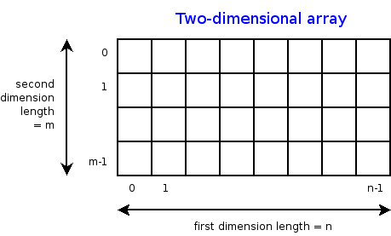
Data Manipulation and Computation
Data Representation, i.e., what is the natural way to think about given data
Data Processing Operations, which take one or more datasets as input and produce one or more datasets as output
Indexing
Slicing/subsetting
Filter
‘map’ → apply a function to every element
’reduce/aggregate’ → combine values across a row or a column (e.g., sum, average, median etc..)
n-dimensional arrays

Slide 52
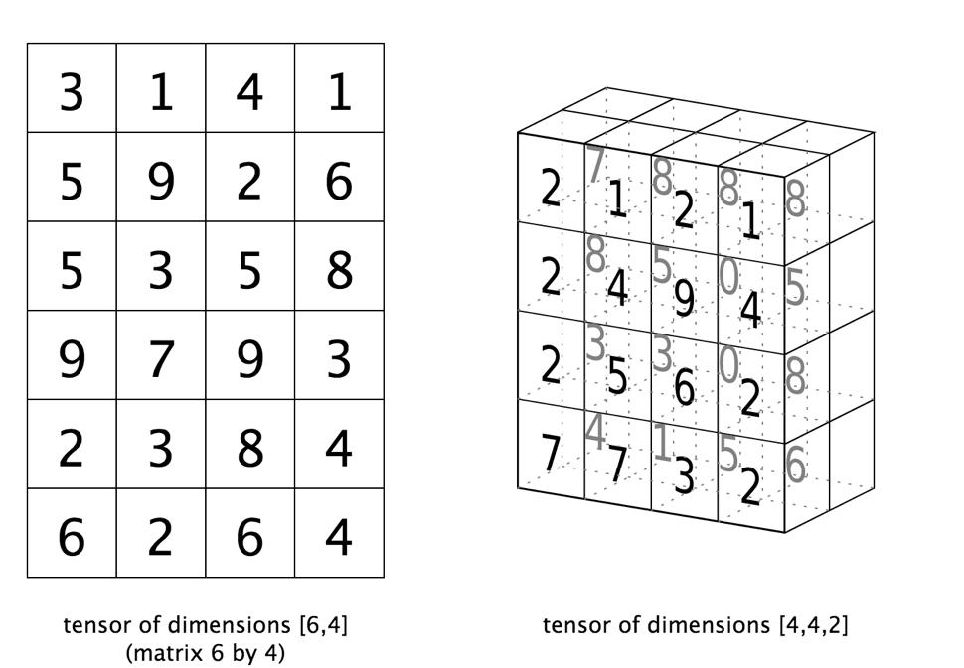
Data Manipulation and Computation
Data Representation, i.e., what is the natural way to think about given data
Data Processing Operations, which take one or more datasets as input and produce one or more datasets as output
Matrices, Tensors
n-dimensional array operations
+
Linear Algebra
Matrix/tensor multiplication
Transpose
Matrix-vector multiplication
Matrix factorization

Slide 53
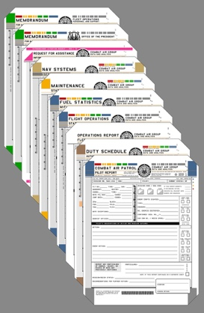
Data Manipulation and Computation
Data Representation, i.e., what is the natural way to think about given data
Data Processing Operations, which take one or more datasets as input and produce one or more datasets as output
Sets: of Objects
Filter
Map
Union
Reduce/Aggregate
Given two sets, Combine/Join using “keys”
Group and then aggregate
Sets: of (Key, Value Pairs)
(amol@cs.umd.edu,(email1, email2,…))
(john@cs.umd.edu,(email3, email4,…))

Slide 54
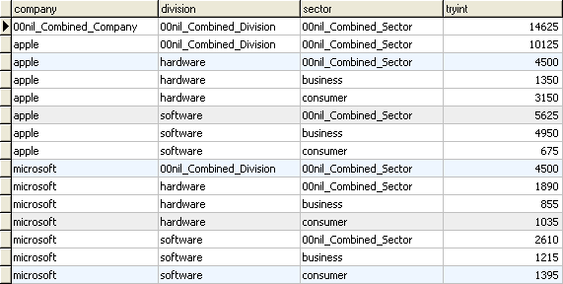
Data Manipulation and Computation
Data Representation, i.e., what is the natural way to think about given data
Data Processing Operations, which take one or more datasets as input and produce one or more datasets as output
Filter rows or columns
”Join” two or more relations
”Group” and “aggregate” them
Relational Algebra formalizes some of them
Structured Query Language (SQL)
Many other languages and constructs, that look very similar
Tables/Relations == Sets of Tuples

Slide 55
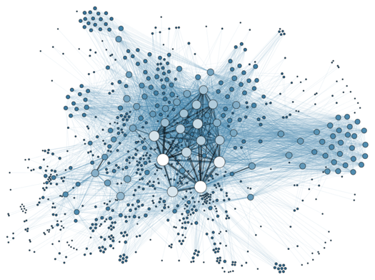
Data Manipulation and Computation
Data Representation, i.e., what is the natural way to think about given data
Data Processing Operations, which take one or more datasets as input and produce one or more datasets as output
Hierarchies/Trees/Graphs
”Path” queries
Graph Algorithms and Transformations
Network Science
Somewhat more ad hoc and special-purpose
Changing in recent years

Slide 56
Data Manipulation and Computation
Data Representation, i.e., what is the natural way to think about given data
Data Processing Operations, which take one or more datasets as input and produce
Why?
Allows one to think at a higher level of abstraction, leading to simpler and easier-to-understand scripts
Provides ”independence” between the abstract operations and concrete implementation
Can switch from one implementation to another easily
For performance debugging, useful to know how they are implemented and rough characteristics

Slide 57
Next Lecture
Data collection
Data processing
Exploratory analysis
&
Data viz
Analysis, hypothesis testing, & ML
Insight & Policy Decision
… on to the “collection” part of things …

