Slide 1
Introduction To
Data Science
John P Dickerson
Lecture #25 – 11/19/2019
CMSC320
Tuesdays & Thursdays
5:00pm – 6:15pm

Slide 2
Today’s Lecture
Data collection
Data processing
Exploratory analysis
&
Data viz
Analysis, hypothesis testing, & ML
Insight & Policy Decision
BIG THANKS: Zico Kolter (CMU)
& Amol Deshpande (UMD)

Slide 3
Statistical Inference
Statistical inference is the discipline that concerns itself with the development of procedures, methods, and theorems that allow us to extract meaning and information from data that has been generated by stochastic (random) processes.
  Process of going from the world to the data, and then back to the world
  Often the goal is to develop a statistical model of the world from observed data
Conclusion is typically:
  an estimate;
  or a confidence interval;
  or rejection of a hypothesis
  or clustering or classification of data points into groups

Slide 4
Basic Probability I
Probability is concerned with the outcome of a trial (also called experiment or observation)
Sample Space: Set of all possible outcomes of a trial
Probability of Sample Space = 1
Event is the specification of the outcome of a trial
  For example: Trial = Tossing a coin; Sample Space = {Heads, Tails}; Event = Heads
If two events E and F are independent, then: Probability of E does not change if F has already happened = P(E), i.e., P(E | F) = P(E)
Also: P(E AND F) = P(E) * P(F)
If two events E and F are mutually exclusive, then: P(E UNION F) = P(E) + P(F)

Slide 5
Basic Probability II
Bayes Theorem P(A | B) = P(B | A) * P(A) / P(B)
Simple equation, but fundamental to Bayesian inference
Conditional Independence: A and B are conditionally independent given C if: Pr(A AND B | C) = Pr(A | C) * Pr(B | C)
Powerful in reducing the computational efforts in storing and manipulating large joint probability distributions
Entropy: A measure of the uncertainty in a probability distribution
Wikipedia Article

Slide 6
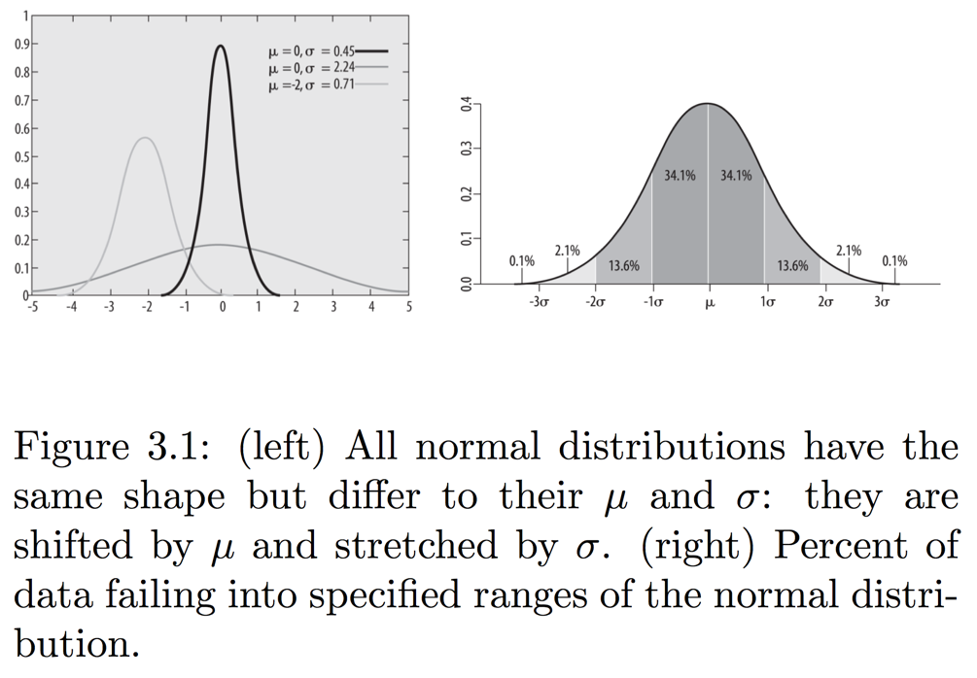
RecaLl: Normal Distribution
99.7% values will fall within 3 standard deviations (around the mean)
  95% for 2 standard deviations; 68% for 1
Central Limit Theorem: As sample size approaches infinity, distribution of sample means will follow a normal distribution irrespective of the original distribution

Slide 7
Hypothesis Testing
Accepting or rejecting a statistical hypothesis about a population
H_0: null hypothesis, and H_1: the alternative hypothesis
  Mutually exclusive and exhaustive
  H_0 can never be proven to be true, but can be rejected
  Sometimes don’t have H_1 at all (Fisher’s test)
Statistical significance: probability that the result is not due to chance
Example: Deciding if a coin is fair
  http://20bits.com/article/hypothesis-testing-the-basics

Slide 8
Hypothesis Testing
H₀: null hypothesis, and H₁: the alternative hypothesis
Mutually exclusive and exhaustive
H₀ can never be proven to be true
Statistical significance: probability that the result is not due to chance
Process:
Decide on H₀ and H₁
Decide which test statistic is appropriate
  Roughly, how well does my sample agree with the null hypothesis?
  Key question: what is the distribution of the test statistic over samples?
Select a significance level (sigma), a probability threshold below which the null hypothesis will be rejected -- typically 5% or 1%.
Compute the observed value of the test statistic t_{obs} from the sample
Compute p-value: the probability that the test statistic took that value by chance
  Use the distribution above to compute the p-value
Reject the null hypothesis if the p-value < \sigma

Slide 9
Summary
Hypothesis testing allows us to formulate beliefs about investment attributes and subject those beliefs to rigorous testing following the scientific method.
  For parametric hypothesis testing, we formulate our beliefs (hypotheses), collect data, and calculate a value of the investment attribute in which we are interested (the test statistic) for that set of data (the sample), and then we compare that with a value determined under assumptions that describe the underlying population (the critical value). We can then assess the likelihood that our beliefs are true given the relationship between the test statistic and the critical value.
  Commonly tested beliefs associated with the expected return and variance of returns for a given investment or investments can be formulated in this way.

Slide 14
Notes:
Var(X) = E[ (X-mu)^2 ]

Slide 15
Notes:
The degrees of freedom (DF) are the amount of information your data provide that you can "spend" to estimate the values of unknown population parameters, and calculate the variability of these estimates. This value is determined by the number of observations in your sample. Increasing your sample size provides more information about the population, and thus increases the degrees of freedom in your data.
The 1-sample t-test estimates only one parameter: the population mean.
The sample size of n constitutes n pieces of information for estimating the population mean and its variability. One degree of freedom is spent estimating the mean, and the remaining n-1 degrees of freedom estimate variability. Therefore, a 1-sample t-test uses a t-distribution with n-1 degrees of freedom
Source: Minitab

Slide 18
Notes:
Null hypothesis tests validity of a claim about a population (e.g., “men and women do not score differently on CMSC320 exams.”)
Alternative hypothesis: men and women score differently / women score higher / women do not score higher (two-sided vs one-sided)
Tp

Slide 19
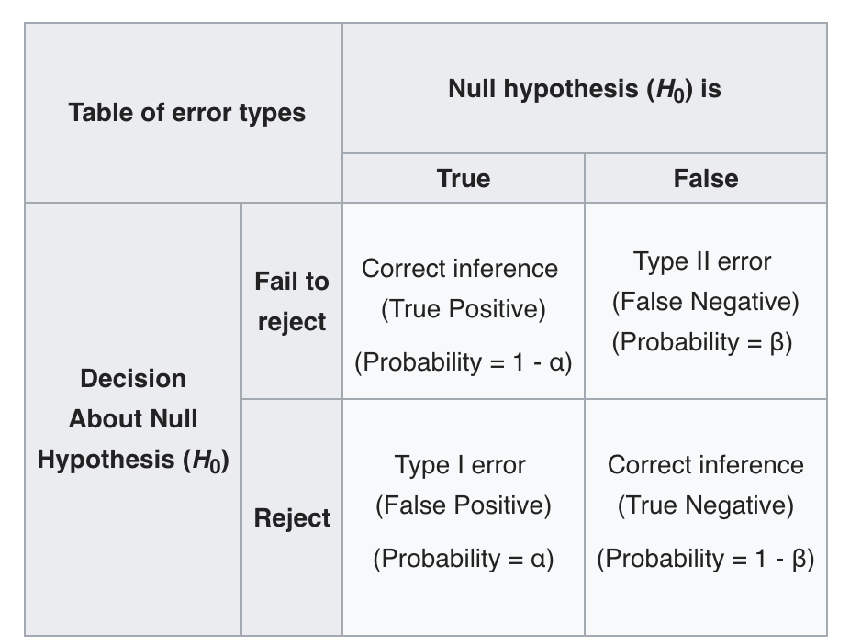
Source: Wikipedia

Slide 30
Scientific method: Statistical Errors
Nature Article
P values not as reliable as many scientists assume
p-hacking: cherry picking data points etc., to get the p-values; repeating experiments if they fail till you get the result
Much discussion/debate about this issue in recent years

Slide 31
Sampling Biases
Sampling effective at reducing the data you need to analyze
Ideally you want random sample
  Otherwise you need to account for bias, which can be tricky
Bias in sampling: need to be very careful when generalizing inferences drawn from a sample
  Even for random samples
Questions to ask: How was the sample selected? Was it truly random? Potential biases? How were questions worded? How is missing data/attrition handled? Was the sample size large enough?

Slide 32
Some Potential Sources of Biases
Sample Bias
  Selection bias: some subjects more likely to be selected
  Volunteer bias: people who volunteer are not representative
  Nonresponse bias: people who decline to be interviewed
Survey/Response Bias
  Interviewer bias
  Acquiescence bias – tendency to agree with all questions
  Social desirability bias: people are not going to admit to embarrassing things
Also watch out for:
  Confirmation bias
  Anchor bias

Slide 33
Some Potential Sources of Biases
Gold Standard: Randomized Clinical Trials
  Some people receive "treatment", others in a "control" group
  Picked randomly to take care of all confounding factors
  Problems:
    Ethically feasible only if
    clinically equipoise
      Can't ask some people to smoke to figure out the effects of smoking
    Very expensive and cumbersome
    Impossible in many cases
Recall: Recent Facebook experiment on emotions
A true state of equipoise exists when one has no good basis for a choice between two or more care options. - NIH

Slide 34
Determining Causation
Bradford Hill’s Criteria: widely accepted in the modern era as useful guidelines for investigating causality in epidemiological studies
  Strength: how large is the association
  Consistency across different samples
  How specific
  Cause should precede effect (temporality)
  Biological gradient (increase dose → increase association)
  Plausibility
  Coherence
  Experiment
  Consideration of alternate explanations

Slide 35
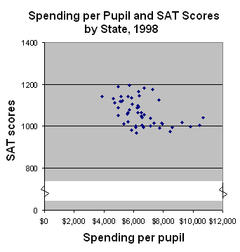
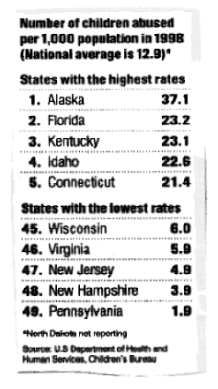
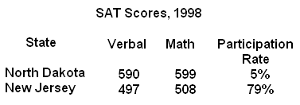
Misuse of Statistics
This famous, but old book on statistics goes into detail about How to lie with statistics

Slide 36
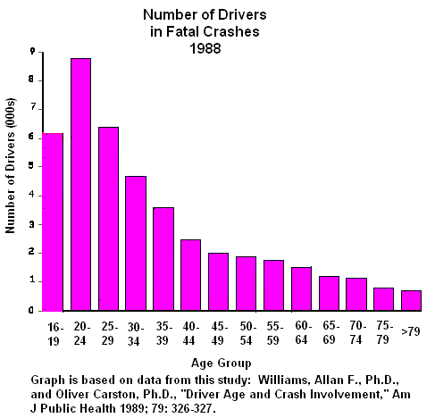
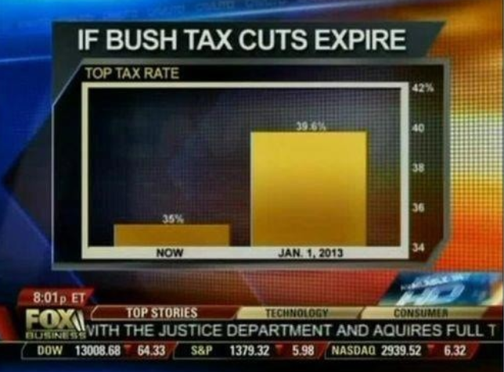
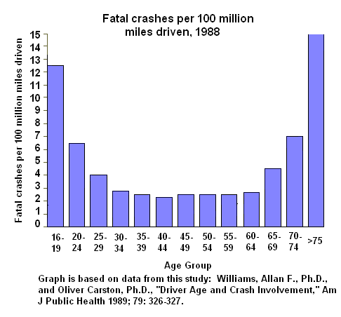
Beware of Charts !

Slide 37
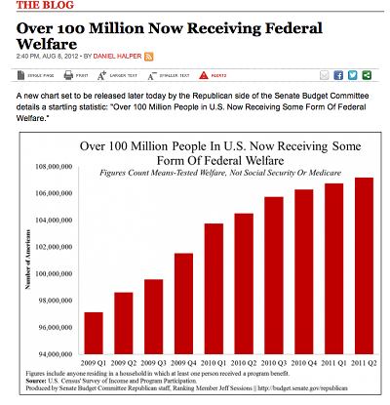
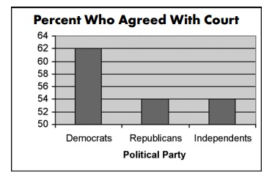
Beware of Charts !
Terry Schiavo Case

Slide 38
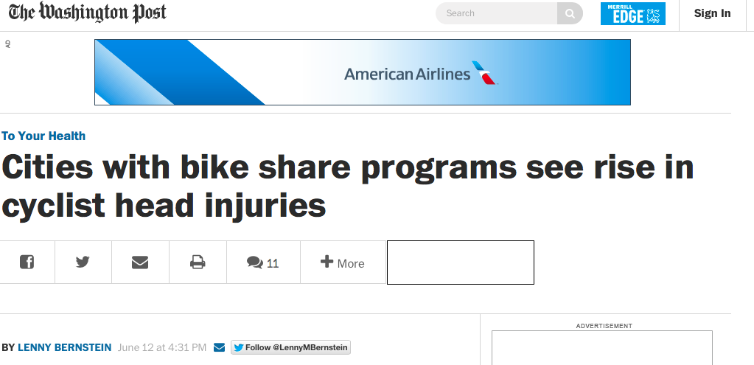
Newspapers even more
Source
A Washington Post article says: In the first study of its kind, researchers from Washington State University and elsewhere found a 14 percent greater risk of head injuries to cyclists associated with cities that have bike share programs. In fact, when they compared raw head injury data for cyclists in five cities before and after they added bike share programs, the researchers found a 7.8 percent increase in the number of head injuries to cyclists.
Actually: head injuries declined from 319 to 273, and overall injuries declined from 757 to 545
  So the proportion of head injuries went up !!

Slide 39
Next up
Data collection
Data processing
Exploratory analysis
&
Data viz
Analysis, hypothesis testing, & ML
Insight & Policy Decision
BIG THANKS: Zico Kolter (CMU)
& Amol Deshpande (UMD)

Slide 40
Outline
Informed Consent
Reproducibility
p-value Hacking
Who owns the data?
Privacy & Anonymity
Debugging Data Science
Algorithmic fairness
Data validity/provenance

Slide 41
Informed Consent
Respect for persons -- cornerstone value for any conception of research ethics
Informed consent de facto way to “operationalize” that principle
  Integral component of medical research for many decades
  Applicable for any research where “personal information” is divulged or human experimentation performed
  Institutional Review Boards (IRBs) in charge of implementing
How it translates into the “big data” world?
  Largely ignored by most researchers
Notes:
Informed consent has been challenged—if not outright undermined—by research activities enabled by increasingly advanced networked information and communication technologies (ICTs) and the massive quantities of social and individually identifiable data they can produce. The rise of “big data” has raised new and compounded existing questions around the ethical treatment of human subjects in research, as legacy models forged in medical and behavioral research contexts are not easily applied to data scientific practice
many researchers and private companies have ignored or outright abandoned core research ethics ideas like “informed consent” as untenable, relying instead on notice and consent practices which do not share the same grounding in research ethics or even moral theory generally. This results in often opaque or impenetrable privacy policies and data use notices or—worse—no notice at all.

Slide 42
History
Systematic scientific experimentation on human subjects rare and isolated prior to the late 19th century
Some early directives in late 19th century and early 20th century
  Prussian directive in 1900: any medical intervention for any purpose other than diagnosis, healing, and immunisation must obtain “unambiguous consent” from patients after “proper explanation of the possible negative consequences” of the intervention
Nuremberg Code, drafted after conclusion of Nazi Doctors’ trials:
  established a universal ethical framework for clinical research
  “the voluntary consent of the human subject is absolutely essential” to ethical research
  Detailed specific guidelines on what to present to subjects (nature/duration/purpose, how conducted, effects on health, etc)
Notes:
Early medical efforts were mostly therapeutic and intended to directly benefit an individual
moral and ethical frameworks governing the actions of doctors (like the Hippocratic Oath) did not address experimentation
In 1891, for example, a Prussian minister released a directive that tuberculin should not be administered as treatment for tuberculosis “against the patient’s will”
In 1898, for example, the German physician Albert Neisser began injecting sex workers with serum from syphilis patients as an experimental method for prevention—albeit without their consent
, the Nuremberg Code breaks somewhat with the earlier German guidelines, as it emphasizes voluntariness over informedness—the first principle of voluntary consent prescribes. Despite the prioritization of voluntariness, the code does note that consent should entail “sufficient knowledge and comprehension of the elements of the subject matter involved, as to enable [the subject] to make an understanding and enlightened decision”. detail specific kinds of information that should be presented during the consenting process: “the nature, duration, and purpose of the experiment; the method and means by which it is to be conducted; all inconveniences and hazards reasonably to be expected; and the effects upon his health or person, which may possibly come from his participation in the experiment”

Slide 43
History
Salgo v Leland Stanford etc. Board of Trustees (1957) … cited as establishing the legal doctrine of informed consent for medical practice and biomedical research in the United States
  plaintiff was awarded damages for not receiving full disclosure of facts
In 1953: NIH put the first IRB in place in its own hospital
  … voluntary agreement based on informed understanding shall be obtained from the patient
  … will be given an oral explanation in terms suited for his comprehension
  Only required a voluntary signed statement if the procedure involved “unusual hazard.”
Notes:
Surgery that went very wrong, wasn’t given full risk info

Slide 44
History
A more detailed list of requirements emerged later
  1) A fair explanation of the procedures to be followed, including an identification of those which are experimental;
  2) A description of the attendant discomforts and risks;
  3) A description of the benefits to be expected;
  4) A disclosure of appropriate alternative procedures that would be advantageous for the subject;
  5) An offer to answer any inquires concerning the procedures;
  6) An instruction that the subject is free to withdraw his consent and to discontinue participation in the project or activity at any time
“Common Rule” – codification of “respect for persons, beneficence, and justice”
  Regulates use of human subjects in US today
  More elaborate treatment of all of these aspects

Slide 45
Non-medical research
Unclear how the rules translate to other types of research
Identifying harm or potential risks difficult
Requirements and experiments change over the course of the study
The list of subjects itself evolving
CS has rarely had to deal with IRBs
  Although changing…
Notes:
Data analyses, in particular, “rarely appear as a direct ‘intervention’ in the life or body of an individual human being” (

Slide 46
Industry research
Less distinction between conventional or academic social scientific research and industry- or market-oriented research
Data fusion can lead to new insights and uses of data
Hard to translate the “informed consent” requirements to these settings

Slide 47
Case study: facebook emotional experiment
Facebook routinely does A/B testing to test out new features (e.g., layouts, features, fonts, etc)
In 2014: intentionally manipulated news feeds of 700k users
  Changed the number of positive and negative stories the users saw
  Measured how the users themselves posted after that
Hypothesis: Emotions spread over the social media
Huge outcry
Facebook claims it gets the “consent” from the user agreement
Notes:
In an academic paper published in conjunction with two university researchers, the company reported that, for one week in January 2012, it had altered the number of positive and negative posts in the news feeds of 689,003 randomly selected users to see what effect the changes had on the tone of the posts the recipients then wrote.
The researchers found that moods were contagious. The people who saw more positive posts responded by writing more positive posts. Similarly, seeing more negative content prompted the viewers to be more negative in their own posts.
Although academic protocols generally call for getting people’s consent before psychological research is conducted on them, Facebook didn’t ask for explicit permission from those it selected for the experiment. It argued that its 1.28 billion monthly users gave blanket consent to the company’s research as a condition of using the service.
Mr. Kramer wrote that changing the emotional makeup of the news feeds had a minimal impact, prompting users to produce an average of one fewer emotional word per thousand words over the following week.
When someone logs in, there are typically about 1,500 items the company could display in that person’s news feed, but the service shows only about 300 of them.
What you see is chosen by a mysterious algorithm that takes into account hundreds of factors, such as how often you comment on your Aunt Sally’s photos, how much your friends are talking about a colleague’s post about her new job, and whether you always watch those cat videos.

Slide 48
Okcupid experiments
Experiment 1: Love is Blind
  Turned off photos for a day
  Activity went way down, but deeper conversations, better responses
  Deeper analysis at the link below
Experiment 2:
  Turned off text or not – kept picture
  Strong support for the hypothesis that the words don’t matter
Experiment 3: Power of Suggestion
  Told people opposite of what the algorithm suggested
https://theblog.okcupid.com/we-experiment-on-human-beings-5dd9fe280cd5

Slide 49
GDPR and Consent
General Data Protection Regulation – new law in EU that recently went into play
Requires unambiguous consent
  data subjects are provided with a clear explanation of the processing to which they are consenting
  the consent mechanism is genuinely of a voluntary and "opt-in" nature
  data subjects are permitted to withdraw their consent easily
  the organisation does not rely on silence or inactivity to collect consent (e.g., pre‑ticked boxes do not constitute valid consent);

Slide 50
Outline
Informed Consent
Reproducibility
p-value Hacking
Who owns the data?
Privacy & Anonymity
Debugging Data Science
Algorithmic fairness
Data validity/provenance

Slide 51


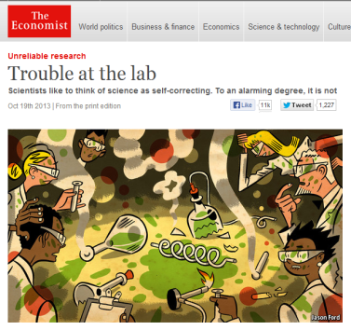
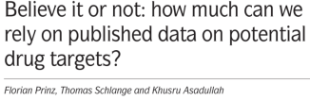



The Reproducibility Challenge
Noted by research community; in multiple publications
  Across research areas
  Especially in preclinical research

Slide 52
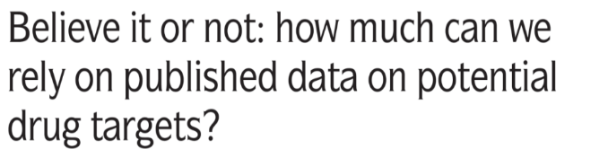
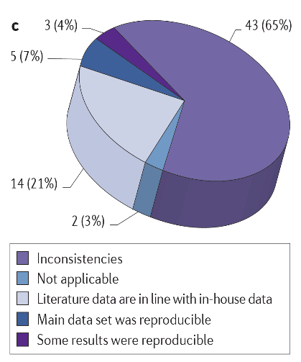
Prinz, Schlange and Asadullah
Bayer HealthCare
Nature Reviews Drug Discovery
2011; 10:712-713
Notes:
http://www.nature.com/nrd/journal/v10/n9/full/nrd3439-c1.html

Slide 53
Notes:
NINDS Workshop: http://www.ninds.nih.gov/funding/areas/channels_synapses_and_circuits/rigor_and_transparency/index.htm
Landis et al article: http://www.nature.com/nature/journal/v490/n7419/full/nature11556.html

Slide 54
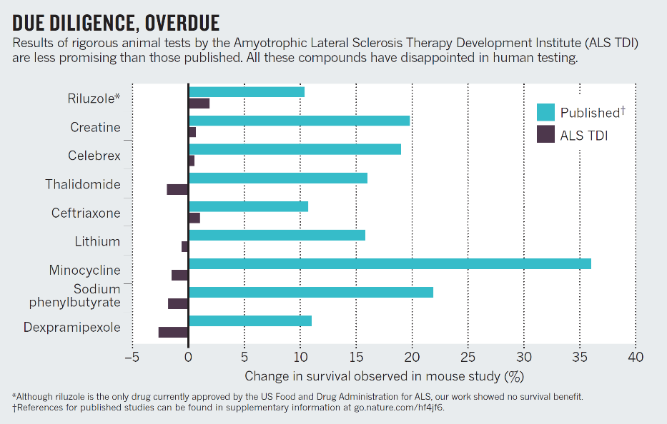
Perrin, Nature 2014; 507: 423-4255
Notes:
http://www.nature.com/news/preclinical-research-make-mouse-studies-work-1.14913

Slide 55
Challenges to Rigor and Transparency in Reporting Science
Science often viewed as self-correcting
  Immune from reproducibility problems?
  Principle remains true over the long-term
In the short- and medium-term, interrelated factors can short-circuit self-correction
  Leads to reproducibility problem
  Loss of time, money, careers, public confidence

Slide 56

Factors that “Short Circuit”
Self-Correction
Current “hyper-competitive” environment fueled, in part, by:
  Historically low funding rates
  Grant review and promotion decisions depend too much on “high profile” publications
$$
Notes:
Current “hyper-competitive” environment fueled, in part, by:
Historically low funding rates
Over-dependence on “high profile” publications when grants are reviewed; institutions are making appointment, promotion, and tenure decisions

Slide 57

Factors that “Short Circuit”
Self-Correction
Publication practices:
  Difficulty in publishing negative findings
  Overemphasis on the “exciting, big picture” finding sometimes results in publications leaving out necessary details of experiments
Notes:
Image by Sławek Borewicz (Own work) [CC BY-SA 3.0 (http://creativecommons.org/licenses/by-sa/3.0)], via Wikimedia Commons

Slide 58
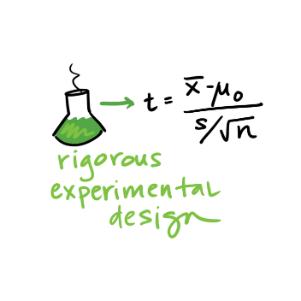
Factors that “Short Circuit”
Self-Correction
Poor training
  Inadequate experimental design
  Inappropriate use of statistics (“p-hacking”)
  Incomplete reporting of resources used and/or unexpected variability in resources
Notes:
Poor training
Inadequate experimental design – fundamental quality characteristics not reported/performed (e.g. blinded assessment, randomization, sample size calculations)
Inappropriate use of statistics (“p-hacking”)
Incomplete reporting of resources used and/or unexpected variability in resources

Slide 59
Reproducibility
Extremely important aspect of data analysis
“Starting from the same raw data, can we reproduce your analysis and obtain the same results?”
Using libraries helps:
Since you don’t reimplement everything, reduce programmer error
Large user bases serve as “watchdog” for quality and correctness
Standard practices help:
Version control: git, git, git, …, git, svn, cvs, hg, Dropbox
Unit testing: unittest (Python), RUnit (R), testthat
Share and publish: github, gitlab
Slides adapted from Hector Corrado Bravo

Slide 60
Practical Tips
Many tasks can be organized in modular manner:
Data acquisition:
  Get data, put it in usable format (many ‘join’ operations), clean it up – Anaconda lab from Tuesday!
Algorithm/tool development:
  If new analysis tools are required
Computational analysis:
  Use tools to analyze data
Communication of results:
  Prepare summaries of experimental results, plots, publication, upload processed data to repositories
Usually a single language or tool does not handle all of these equally well – choose the best tool for the job!

Slide 61
Practical Tips
Modularity requires organization and careful thought
In Data Science, we wear two hats:
Algorithm/tool developer
Experimentalist: we don’t get trained to think this way enough!
It helps two consciously separate these two jobs

Slide 62
Think like an experimentalist
Plan your experiment
Gather your raw data
Gather your tools
Execute experiment
Analyze
Communicate

Slide 63
Think like an experimentalist
Let this guide your organization. One potential structure for organizing a project:
project/
| data/
| | processing_scripts
| | raw/
| | proc/
| tools/
| | src/
| | bin/
| exps
| | pipeline_scripts
| | results/
| | analysis_scripts
| | figures/

Slide 64
Think like an experimentalist
Keep a lab notebook!
Literate programming tools are making this easier for computational projects:
http://en.wikipedia.org/wiki/Literate_programming (Lec #2!)
https://ipython.org/
http://rmarkdown.rstudio.com/
http://jupyter.org/

Slide 65
Think like an experimentalist
Separate experiment from analysis from communication
Store results of computations, write separate scripts to analyze results and make plots/tables
Aim for reproducibility
There are serious consequences for not being careful
  Publication retraction
  Worse: http://videolectures.net/cancerbioinformatics2010_baggerly_irrh/
Lots of tools available to help, use them! Be proactive: learn about them on your own!

Slide 66
Outline
Informed Consent
Reproducibility
p-value Hacking
Who owns the data?
Privacy & Anonymity
Debugging Data Science
Algorithmic fairness
Data validity/provenance

Slide 67
American Statistical Association Statement on p-Values
Q:Why do so many colleges and grad schools teach p =0.05?
A: Because that’s still what the scientific community and journal editors use.
Q:Why do so many people still use p = 0.05?
A:Because that’s what they were taught in college or grad school.
ASA statement
- George Cobb, Professor Emeritus of Mathematics and Statistics - Mt Holyhoke College

Slide 68
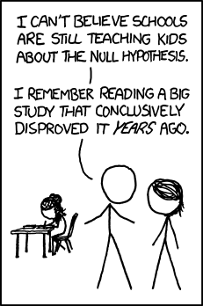
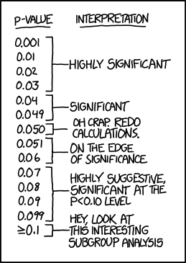
What is a p-value?

Slide 69
Misconceptions about the p-value
The p-value is not the probability that the null hypothesis is true or the probability that the alternative hypothesis is false. It is not connected to either.
The p-value is not the probability that a finding is "merely a fluke."
The p-value is not the probability of falsely rejecting the null hypothesis.
The p-value is not the probability that replicating the experiment would yield the same conclusion.
The significance level, such as 0.05, is not determined by the p-value.
The p-value does not indicate the size or importance of the observed effect.
Misconceptions about p-value has its own Wikipedia page

Slide 70
What is a p-value?
Informally, a p-value is the probability under a specified statistical model that a statistical summary of the data (e.g., the sample mean difference between two compared groups) would be equal to or more extreme than its observed value.

Slide 71
Principle 1
P-values can indicate how incompatible the data are with a specified statistical model.
The smaller the p-value, the greater the statistical incompatibility of the data with the null hypothesis, if the underlying assumptions used to calculate the p-value hold.
This incompatibility can be interpreted as casting doubt on or providing evidence against the null hypothesis or the underlying assumptions.

Slide 72
Principle 2
P-values do not measure the probability that the studied hypothesis is true, or the probability that the data were produced by random chance alone.
The p-value is a statement about data in relation to a specified hypothetical explanation, and is not a statement about the explanation itself.

Slide 73
Principle 2 – Don’t flip the conditionality
p-value is not
P(Ho is true | getting data this extreme)
p-value is
P(getting data this extreme | Ho is true)

Slide 74
Illustrative Example (Bayesian)
Suppose there is a 5% probability that a research hypothesis (Ha) is true (prior).
You conduct the test with 90% power.
The p-value of the test is 0.04
Using Bayes’ Rule:

Slide 75
Principle 3
Scientific conclusions and business or policy decisions should not be based only on whether a p-value passes a specific threshold
A conclusion does not immediately become “true” on one side of the divide and “false” on the other.
Researchers should bring many contextual factors into play to derive scientific inferences, including the design of a study, the quality of the measurements, the external evidence for the phenomenon under study, and the validity of assumptions that underlie the data analysis.

Slide 76
Principle 4
Proper inference requires full reporting and transparency
p-values and related analyses should not be reported selectively.
Cherry picking promising findings, also known by such terms as data dredging, significance chasing, significance questing, selective inference, and
“p-hacking,” leads to a spurious excess of statistically significant results in the published literature and should be vigorously avoided.
Example of p-hacking (from xkcd)

Slide 77
Principle 5
A p-value, or statistical significance, does not measure the size of an effect or the importance of a result.
Statistical significance is not equivalent to scientific, human, or economic significance.
Smaller p-values do not necessarily imply the presence of larger or more important effects, and larger p-values do not imply a lack of importance or even lack of effect.
Some research journals no longer look at p-values, but instead look at effect sizes.

Slide 78
Principle 6
By itself, a p-value does not provide a good measure of evidence regarding a model or hypothesis.
Researchers should recognize that a p-value without context or other evidence provides limited information.
A relatively large p-value does not imply evidence in favor of the null hypothesis; many other hypotheses may be equally or more consistent with the observed data.

Slide 79
Other Approaches
Methods that emphasize estimation over testing, such as confidence, credibility, or prediction intervals
Bayesian methods
Alternative measures of evidence, such as likelihood ratios or Bayes Factors
Other approaches such as decision-theoretic modeling and false discovery rates

Slide 80
False-Positives are Easy
It is common practice in all sciences to report less than everything.
  So people only report the good stuff. We call this p-Hacking.
  Accordingly, what we see is too “good” to be true.
We identify six ways in which people do that.

Slide 81
Six Ways to p-Hack
Stop collecting data once p<.05
Analyze many measures,but report only those with p<.05.
Collect and analyze many conditions, but only report those with p<.05.
Use covariates to get p < .05.
Exclude participants to get p<.05.
Transform the data to get p<.05.

Slide 82
OK, but does that matter very much?
As a field we have agreed on p<.05. (i.e., a 5% false positive rate).
If we allow p-hacking, then that false positive rate is actually 61%.
Conclusion: p-hacking is a potential catastrophe to scientific inference.

Slide 83
Transparent Reporting
Solution 1:
  Report sample size determination.
  N > 20
  List all of your measures.
  List all of your conditions.
  If excluding, report without exclusion as well.
  If covariates, report without.

Slide 84
Transparent Reporting
Solution 2:
  Report sample size determination.
  N > 20
  List all of your measures.
  List all of your conditions.
  If excluding, report without exclusion as well.
  If covariates, report without.

Slide 85
Conclusion
Good statistical practice, as an essential component of good scientific practice, emphasizes:
  principles of good study design and conduct
  a variety of numerical and graphical summaries of data
  understanding of the phenomenon under study
  Interpretation of results in context
  complete reporting
  Proper logical and quantitative understanding of what data summaries mean
No single index should substitute for scientific reasoning.

Slide 86
Outline
Informed Consent
Reproducibility
p-value Hacking
Who owns the data?
Privacy & Anonymity
Debugging Data Science
Algorithmic fairness
Data validity/provenance

Slide 87
Data ownership
Consider your “biography”
  About you, but is it yours?
  No, the authors owns the copyright – not much you can do
If someone takes your photo, they own it
  Limits on taking photos in private areas
  Can’t use the photo in certain ways, e.g., as implied endorsement or implied libel
Intellectual Property Basics:
  Copyright vs Patent vs Trade Secret
  Derivative works

Slide 88
Data ownership
Data Collection and Curation takes a lot of effort, and whoever does this usually owns the data “asset”
Crowdsourced data typically belongs to the facilitator
  Rotten tomatoes, yelp, etc.
What about personal data though?
  e.g., videos of you walking around a store, etc?
  Written contracts in some cases, but not always
New regulations likely to come up allowing customers to have more control over what happens with their data (e.g., GDPR)

Slide 89
Outline
Informed Consent
Reproducibility
p-value Hacking
Who owns the data?
Privacy & Anonymity
Algorithmic fairness
Data validity/provenance

Slide 90
Privacy
First concern that comes to mind
  How to avoid the harms that can occur due to data being collected, linked, analyzed, and propagated?
  Reasonable rules ?
  Tradeoffs?
No option to exit
  In the past, could get a fresh start by moving to a new place, waiting till the past fades
  big data is universal and never forgets
  Data science results in major asymmetries in knowledge

Slide 91
Wayback machines
Archives pages on the web (https://archive.org/web/ - 300 billion pages saved over time)
  almost everything that is accessible
  should be retained forever
If you have an unflattering page written about you, it will survive for ever in the archive (even if the original is removed)

Slide 92
Right to be forgotten
Laws are often written to clear a person’s record Law in EU and Argentina since 2006 after some years.
impacts search engines (not removed completely, but hard to find)
Collection vs Use
  Privacy usually harmed upon use of data
  Sometimes collection without use may be okay
  Survenillance:
    By the time you know what you need, it is too late to go back and get it

Slide 93

Why Privacy?
Data subjects have inherent right and expectation of privacy
“Privacy” is a complex concept
  What exactly does “privacy” mean? When does it apply?
  Could there exist societies without a concept of privacy?
Concretely: at collection “small print” outlines privacy rules
  Most companies have adopted a privacy policy
  E.g. AT&T privacy policy att.com/gen/privacy-policy?pid=2506
Significant legal framework relating to privacy
  UN Declaration of Human Rights, US Constitution
  HIPAA, Video Privacy Protection, Data Protection Acts

Slide 94

Release the data “anonymously” or release a model?
Server
D_{B}"
Individual 1
r₁"
Individual 2
r₂"
Individual 3
r₃"
Individual N&
r_{N}"

Slide 95
Why Anonymize?
For Data Sharing
  Give real(istic) data to others to study without compromising privacy of individuals in the data
  Allows third-parties to try new analysis and mining techniques not thought of by the data owner
For Data Retention and Usage
  Various requirements prevent companies from retaining customer information indefinitely
  E.g. Google progressively anonymizes IP addresses in search logs
  Internal sharing across departments (e.g. billing → marketing)

Slide 96
Why Anonymize?

Slide 97
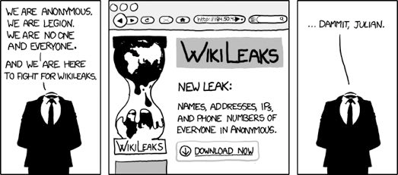
Releasing data is bad?
What if we ensure our names and other identiﬁers are never released?

Slide 98

Case Study: US Census
Raw data: information about every US household
  Who, where; age, gender, racial, income and educational data
Why released: determine representation, planning
How anonymized: aggregated to geographic areas (Zip code)
  Broken down by various combinations of dimensions
  Released in full after 72 years
Attacks: no reports of successful deanonymization
  Recent attempts by FBI to access raw data rebuffed
Consequences: greater understanding of US population
  Affects representation, funding of civil projects
  Rich source of data for future historians and genealogists

Slide 99

Case Study: Netflix Prize
Raw data: 100M dated ratings from 480K users to 18K movies
Why released: improve predicting ratings of unlabeled examples
How anonymized: exact details not described by Netflix
  All direct customer information removed
  Only subset of full data; dates modified; some ratings deleted,
  Movie title and year published in full
Attacks: dataset is claimed vulnerable [Narayanan Shmatikov 08]
  Attack links data to IMDB where same users also rated movies
  Find matches based on similar ratings or dates in both
Consequences: rich source of user data for researchers
  unclear if attacks are a threat—no lawsuits or apologies yet

Slide 100

The Massachusetts Governor Privacy Breach [Sweeney IJUFKS 2002]
Name
SSN
Visit Date
Diagnosis
P rocedure
Medication
T otal Charge
Zip
Birth date
Sex
Medical Data

Slide 101

The Massachusetts Governor Privacy Breach [Sweeney IJUFKS 2002]
Name
S SN
Visit Date
D iagnosis
P rocedure
Medication
T otal Charge
Name
A ddress
Date Registered
P arty aﬃliation
Date last voted
Zip
Birth date
Sex
Medical Data

Slide 102
The Massachusetts Governor Privacy Breach [Sweeney IJUFKS 2002]
Name
SSN
V isit Date
D iagnosis
Procedure
Medication
T otal Charge
Name
A ddress
Date Registered
P arty aﬃliatioon
Date last voted
Governor of MA uniquely identiﬁed using ZipCode, Birth Date, and Sex.
Zip
Birth date
Sex
Name linked to Diagnosis
Medical Data
Voter List

Slide 103

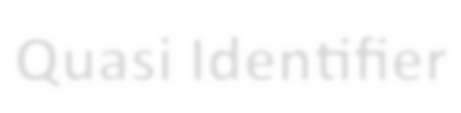
The Massachusetts Governor Privacy Breach [Sweeney IJUFKS 2002]
87 % of US population uniquely identified
Name
SSN
V isit Date
D iagnosis
Procedure
Medication
T otal Charge
Name
A ddress
Date Registered
P arty aﬃliatioon
Date last voted
Governor of MA
Zip
using ZipCode,
Birth Date, and Sex.
Birth date
Sex
Quasi-Identiﬁers
Medical Data
Voter List

Slide 104

AOL data publishing fiasco …
AOL “anonymously” released a list of 21 million web search queries.
Ashwin222 Ashwin222 Ashwin222 Ashwin222 Pankaj156 Pankaj156 Cox12345 Cox12345 Cox12345 Cox12345
Ashwin222
Ashwin222
Uefa cup
Uefa champions league Champions league final Champions league final 2007 exchangeability
Proof of deFinitti s theorem Zombie games
Warcraft
Beatles anthology Ubuntu breeze
Grammy 2008 nominees
Amy Winehouse rehab

Slide 105
AOL data publishing fiasco …
AOL “anonymously” released a list of 21 million web search queries.
UserIDs were replaced by random numbers …
865712345 | Uefa cup
865712345 | Uefa champions league
865712345 | Champions league final
865712345 | Champions league final 2007
236712909 | exchangeability
236712909 | Proof of deFinitti s theorem
112765410 | Zombie games
112765410 | Warcraft
112765410 | Beatles anthology
112765410 | Ubuntu breeze
865712345 | Grammy 2008 nominees
865712345 | Amy Winehouse rehab

Slide 106

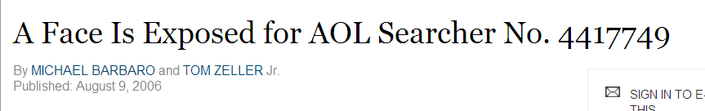
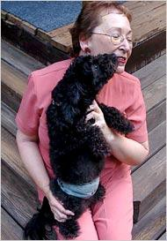
Privacy Breach
[NYTimes 2006]

Slide 107

Case Study: AOL Search Data
Raw data: 20M search queries for 650K users from 2006
Why released: allow researchers to understand search patterns
How anonymized: user identifiers removed
  All searches from same user linked by an arbitrary identifier
Attacks: many successful attacks identified individual users
  Ego-surfers: people typed in their own names
  Zip codes and town names identify an area
  NY Times identified 4417749 as 62yr old GA widow [Barbaro Zeller 06]
Consequences: CTO resigned, two researchers fired
  Well-intentioned effort failed due to inadequate anonymization

Slide 108


Can we release a model alone?
Release the data “anonymously” or release a model
Server
D_{B}"
Individual 1
r₁"
Individual 2
r₂"
Individual 3
r₃"
Individual N&
r_{N}"

Slide 109

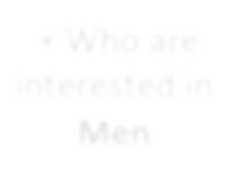
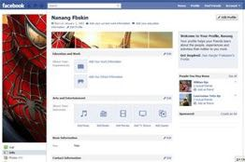

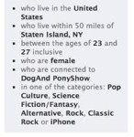

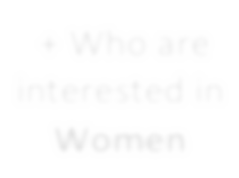
Releasing a model can also be bad
[Korolova JPC 2011]
Number of
Facebook proﬁle
Impressions
25
+ Who are interested in Men
+
Online Data
+ Who are interested in Women
0
Facebook's learning algorithm uses private information to predict match to ad

Slide 110
Model Inversion
[Frederickson et al., USENIX Security 2014]
An attacker, given the model and some demographic information about a patient, can predict the patient's genetic markers.

Slide 111
Models of Anonymization
Interactive Model (akin to statistical databases)
  Data owner acts as “gatekeeper” to data
  Researchers pose queries in some agreed language
  Gatekeeper gives an (anonymized) answer, or refuses to answer
“Send me your code” model
  Data owner executes code on their system and reports result
  Cannot be sure that the code is not malicious
Offline, aka “publish and be damned” model
  Data owner somehow anonymizes data set
  Publishes the results to the world, and retires
  Our focus in this tutorial – seems to model most real releases

Slide 112
Objectives for Anonymization
Prevent (high confidence) inference of associations
  Prevent inference of salary for an individual in “census”
  Prevent inference of individual’s viewing history in “video”
  Prevent inference of individual’s search history in “search”
  All aim to prevent linking sensitive information to an individual
Prevent inference of presence of an individual in the data set
  Satisfying “presence” also satisfies “association” (not vice-versa)
  Presence in a data set can violate privacy (eg STD clinic patients)
Have to model what knowledge might be known to attacker
  Background knowledge: facts about the data set (X has salary Y)
  Domain knowledge: broad properties of data (illness Z rare in men)

Slide 113
Utility
Anonymization is meaningless if utility of data not considered
  The empty data set has perfect privacy, but no utility
  The original data has full utility, but no privacy
What is “utility”? Depends what the application is…
  For fixed query set, can look at max, average distortion
  Problem for publishing: want to support unknown applications!
  Need some way to quantify utility of alternate anonymizations

Slide 114
Privacy is not Anonymity
Bob's record is indistinguishable from records of other Cancer patients
  We can infer Bob has Cancer !
“New Information” principle
  Privacy is breached if releasing D (or f(D)) allows an adversary to learn
sufficient new information.
  New Information = distance(adversary's prior belief, adversary's posterior belief after seeing D)
  New Information can't be 0 if the output D or f(D) should be useful.

Slide 115
Privacy Definitions
Many privacy definitions
  L-diversity, T-closeness, M-invariance, ε- Differential privacy, E- Privacy, …
Definitions differs in
  What information is considered sensitive
    Specific attribute (disease) vs all possible properties of an individual
  What is the adversary's prior
    All values are equally likely vs Adversary knows everything about all but one
individuals
  How is new information measured
    Information theoretic measures
    Pointwise absolute distance
    Pointwise relative distance

Slide 116
No Free Lunch
Why can't we have a single definition for privacy?
– For every adversarial prior and every property about an individual, new information is bounded by some constant.
No Free Lunch Theorem: For every algorithm that outputs a D with even a sliver of utility, there is some adversary with a prior such that privacy is not guaranteed.

Slide 117
randomized Response Model
N respondents asked a sensitive “yes/no” question.
Surveyor wants to compute fraction π who answer “yes”.
Respondents don't trust the surveyor.
What should the respondents do?

Slide 118
randomized Response Model
Flip a coin
  heads with probability p, and
  tails with probability 1-p (p > ½)
Answer question according to the following table:
 | True Answer = Yes | True Answer = No
Heads | Yes | No
Tails | No | Yes

Slide 119
Sample Microdata
SSN | Zip | Age | Nationality | Disease
631-35-1210 | 13053 | 28 | Russian | Heart
051-34-1430 | 13068 | 29 | American | Heart
120-30-1243 | 13068 | 21 | Japanese | Viral
070-97-2432 | 13053 | 23 | American | Viral
238-50-0890 | 14853 | 50 | Indian | Cancer
265-04-1275 | 14853 | 55 | Russian | Heart
574-22-0242 | 14850 | 47 | American | Viral
388-32-1539 | 14850 | 59 | American | Viral
005-24-3424 | 13053 | 31 | American | Cancer
248-223-2956 | 13053 | 37 | Indian | Cancer
221-22-9713 | 13068 | 36 | Japanese | Cancer
615-84-1924 | 13068 | 32 | American | Cancer

Slide 120
Removing SSN …
Zip | Age | Nationality | Disease
13053 | 28 | Russian | Heart
13068 | 29 | American | Heart
13068 | 21 | Japanese | Viral
13053 | 23 | American | Viral
14853 | 50 | Indian | Cancer
14853 | 55 | Russian | Heart
14850 | 47 | American | Viral
14850 | 59 | American | Viral
13053 | 31 | American | Cancer
13053 | 37 | Indian | Cancer
13068 | 36 | Japanese | Cancer
13068 | 32 | American | Cancer

Slide 121
Linkage Attacks
Zip | Age | Nationality | Disease
13053 | 28 | Russian | Heart
13068 | 29 | American | Heart
13068 | 21 | Japanese | Viral
13053 | 23 | American | Viral
14853 | 50 | Indian | Cancer
14853 | 55 | Russian | Heart
14850 | 47 | American | Viral
14850 | 59 | American | Viral
13053 | 31 | American | Cancer
13053 | 37 | Indian | Cancer
13068 | 36 | Japanese | Cancer
13068 | 32 | American | Cancer
Quasi-
Identifier
Public Information

Slide 122
K-Anonymity
[Samarati et al, PODS 1998]
Generalize, modify, or distort quasi-identifier values so that no
individual is uniquely identifiable from a group of k
In SQL, table T is k-anonymous if each
SELECT COUNT(*) FROM T
GROUP BY Quasi-Identifier
is ≥ k
Parameter k indicates the “degree” of anonymity

Slide 123


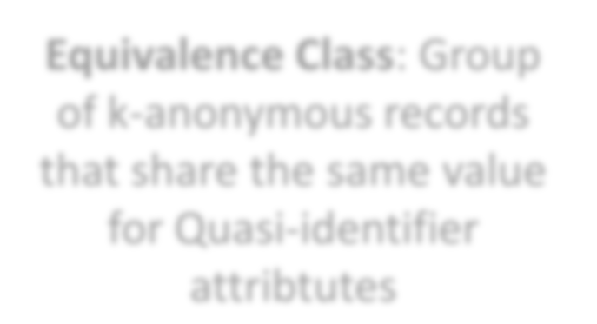
Example: Generalization (Coarsening)
 |  |  | Disease
13053 | 28 | Russian | Heart
13068 | 29 | American | Heart
13068 | 21 | Japanese | Flu
13053 | 23 | American | Flu
14853 | 50 | Indian | Cancer
14853 | 55 | Russian | Heart
14850 | 47 | American | Flu
14850 | 59 | American | Flu
13053 | 31 | American | Cancer
Zip | Age | Nationality | Disease
130** | <30 | * | Heart
130** | <30 | * | Heart
130** | <30 | * | Flu
130** | <30 | * | Flu
1485* | >40 | * | Cancer
1485* | >40 | * | Heart
1485* | >40 | * | Flu
1485* | >40 | * | Flu
130** | 30-40 | * | Cancer
130** | 30-40 | * | Cancer
130** | 30-40 | * | Cancer
130** | 30-40 | * | Cancer
Zip Age Nationality
Eq₃₇uivalenc_{I}e_{nd}C_{ia}l_{n}ass: Gro_{Ca}u_{n}p_{cer}
13053
of k-anonymous records
13068
36 Japanese Cancer
that share the same value
13068
32 American
Cancer
for Quasi-identifier
attribtutes

Slide 124
K-anonymity through Microaggregation
 |  |  | Disease
13053 | 28 | Russian | Heart
13068 | 29 | American | Heart
13068 | 21 | Japanese | Flu
13053 | 23 | American | Flu
14853 | 50 | Indian | Cancer
14853 | 55 | Russian | Heart
14850 | 47 | American | Flu
14850 | 59 | American | Flu
13053 | 31 | American | Cancer
13053 | 37 | Indian | Cancer
13068 | 36 | Japanese | Cancer
13068 | 32 | American | Cancer
Zip Age Nationality
Zip | Age | Nationality | Disease
4 tuples Zip code = 130** 23 < Age < 29 |  |  | 2 Heart and 2 Flu
Average(age) = 25
4 tuples |  |  | 1 Cancer,
Zip = 1485* 47 < Age < 59 |  |  | 1 Heart and
Average(age) = 53 |  |  | 2 Flu
4 tuples Zip = 130** 31 < Age < 37 |  |  | All Cancer patients
Avergae(age) = 34

Slide 125

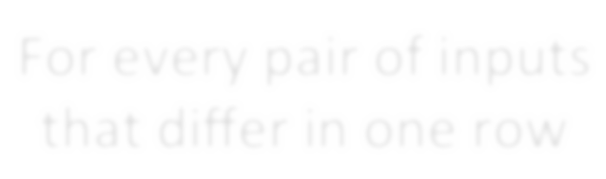



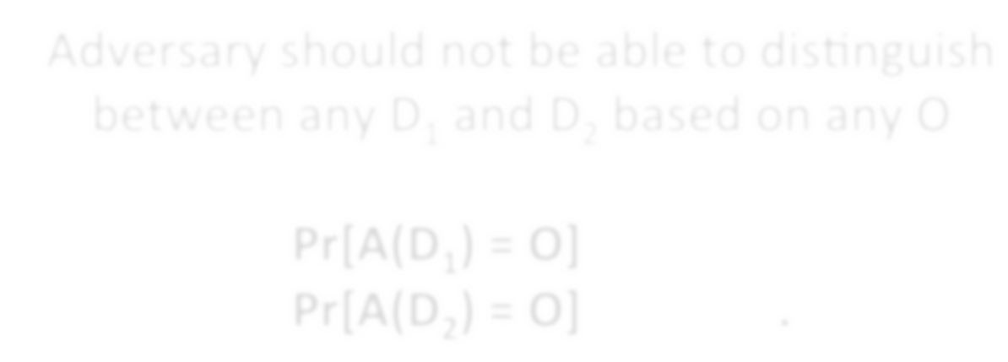
DiFFerential Privacy
[Dwork ICALP 2006]
For every pair of inputs that diﬀer in one row
For every output …
^{D}1 ^{D}2
O
Adversary should not be able to distinguish between any D₁ and D₂ based on any O

Slide 126
DiFFerential Privacy
Typically achieved by adding controlled noise (e.g., Laplace Mechanism)
Some adoption in the wild:
  US Census Bureau
  Google, Apple, and some others have used this for collecting data
Issues:
  Effectiveness in general still unclear

Slide 127
Outline
Informed Consent
Reproducibility
p-value Hacking
Who owns the data?
Privacy & Anonymity
Debugging Data Science
Algorithmic fairness
Other Issues
Data Science in Industry

Slide 144
The dream
You run your ML algorithm(s) and it works well (?!)
Still: be skeptical …
Very easy to accidentally let your ML algorithm cheat:
Peaking (train/test bleedover)
Including output as an input feature explicitly
Including output as an input feature implicitly
Try to solve the problem by hand;
Try to interpret the ML algorithm / output
Continue being skeptical. Always be skeptical.

Slide 145
Outline
Informed Consent
Reproducibility
p-value Hacking
Who owns the data?
Privacy & Anonymity
Algorithmic fairness
Data validity/provenance

Slide 146
Data Science Lifecycle: An Alternate View

Slide 147
Combating bias
Fairness through blindness:
Don’t let an algorithm look at protected attributes
Examples currently in use ??????????
Race
Gender
Sexuality
Disability
Religion
Problems with this approach ?????????

Slide 148
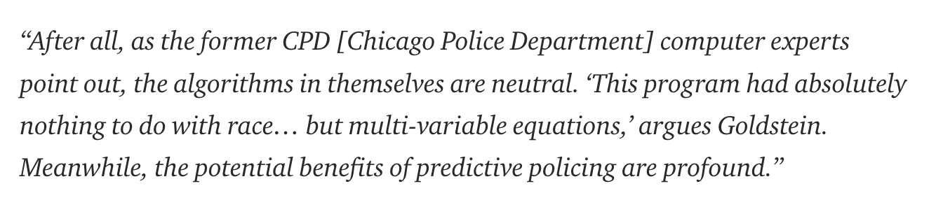
Combating bias

Slide 149
Combating bias
If there is bias in the training data, the algorithm/ML technique will pick it up
  Especially social biases against minorities
  Even if the the protected attributes are not used
Sample sizes tend to vary drastically across groups
  Models for the groups with less representation are less accurate
  Hard to correct this, and so fundamentally unfair
  e.g., a classifier that performs no better than coin toss on a minority group, but does very well on a majority group

Slide 150
Combating bias
Cultural Differences
  Consider a social network that tried to classify user names into real and fake
  Diversity in names differs a lot – in some cases, short common names are ‘real’, in others long unique names are ‘real’

Slide 151
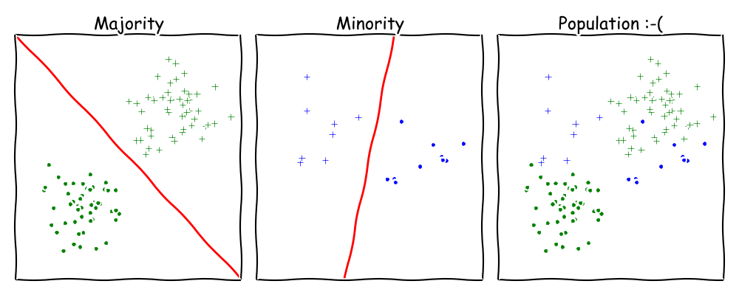
Combating bias
Undesired complexity
  Learning combinations of linear classifiers much harder than learning linear classifiers

Slide 152
Combating Bias
Demographic parity:
A decision must be independent of the protected attribute
E.g., a loan application’s acceptance rate is independent of an applicant’s race (but can be depenedent on non-protected features like salary)
Formally: binary decision variable C, protected attribute A
P{ C = 1 | A = 0 } = P{ C = 1 | A = 1 }
Membership in a protected class should have no correlation with the final decision.
Problems ????????
Example from Moritz Hardt’s blog

Slide 153
Combating Bias
What if the decision isn’t the thing that matters?
“Consider, for example, a luxury hotel chain that renders a promotion to a subset of wealthy whites (who are likely to visit the hotel) and a subset of less affluent blacks (who are unlikely to visit the hotel). The situation is obviously quite icky, but demographic parity is completely fine with it so long as the same fraction of people in each group see the promotion.”
Demographic parity allows classifiers that select qualified candidates in the “majority” demographic and unqualified candidate in the “minority” demographic, within a protected attribute, so long as the expected percentages work out.
More: http://blog.mrtz.org/2016/09/06/approaching-fairness.html
Example from Moritz Hardt’s blog

Slide 154

FATML
This stuff is really tricky (and really important).
It’s also not solved, even remotely, yet!
New community: Fairness, Accountability, and Transparency in Machine Learning (aka FATML)
“… policymakers, regulators, and advocates have expressed fears about the potentially discriminatory impact of machine learning, with many calling for further technical research into the dangers of inadvertently encoding bias into automated decisions.”

Slide 155
F is for Fairness
In large data sets, there is always proportionally less data available about minorities.
Statistical patterns that hold for the majority may be invalid for a given minority group.
Fairness can be viewed as a measure of diversity in the combinatorial space of sensitive attributes, as opposed to the geometric space of features.
Thanks to: Faez Ahmed

Slide 156
A is for accountability
Accountability of a mechanism implies an obligation to report, explain, or justify algorithmic decision-making as well as mitigate any negative social impacts or potential harms.
Current accountability tools were developed to oversee human decision makers
They often fail when applied to algorithms and mechanisms instead
Example, no established methods exist to judge the intent of a piece of software. Because automated decision systems can return potentially incorrect, unjustified or unfair results, additional approaches are needed to make such systems accountable and governable.
Thanks to: Faez Ahmed

Slide 157
T is for transparency
Automated ML-based algorithms make many important decisions in life.
Decision-making process is opaque, hard to audit
A transparent mechanism should be:
understandable;
more meaningful;
more accessible; and
more measurable.
Thanks to: Faez Ahmed

Slide 158
Data collection
What data should (not) be collected
Who owns the data
Whose data can (not) be shared
What technology for collecting, storing, managing data
Whose data can (not) be traded
What data can (not) be merged
What to do with prejudicial data
Thanks to: Kaiser Fung

Slide 159
Data Modeling
Data is biased (known/unknown)
Invalid assumptions
Confirmation bias
Publication bias
WSDM 2017: https://arxiv.org/abs/1702.00502
Badly handling missing values
Thanks to: Kaiser Fung

Slide 160
Deployment
Spurious correlation / over-generalization
Using “black-box” methods that cannot be explained
Using heuristics that are not well understood
Releasing untested code
Extrapolating
Not measuring lifecycle performance (concept drift in ML)
We will go over ways to counter this in the ML/stats/hypothesis testing portion of the course
Thanks to: Kaiser Fung

Slide 161
Guiding principles
Start with clear user need and public benefit
Use data and tools which have minimum intrusion necessary
Create robust data science models
Be alert to public perceptions
Be as open and accountable as possible
Keep data secure
Thanks to: UK cabinet office

Slide 162
Some references
Presentation on ethics and data analysis, Kaiser Fung @ Columbia Univ. http://andrewgelman.com/wp-content/uploads/2016/04/fung_ethics_v3.pdf
O’Neil, Weapons of math destruction. https://www.amazon.com/Weapons-Math-Destruction-Increases-Inequality/dp/0553418815
UK Cabinet Office, Data Science Ethical Framework. https://www.gov.uk/government/publications/data-science-ethical-framework
Derman, Modelers’ Hippocratic Oath. http://www.iijournals.com/doi/pdfplus/10.3905/jod.2012.20.1.035
Nick D’s MIT Tech Review Article. https://www.technologyreview.com/s/602933/how-to-hold-algorithms-accountable/

Slide 163
Outline
Informed Consent
Reproducibility
p-value Hacking
Who owns the data?
Privacy & Anonymity
Algorithmic fairness
Some other issues
Data Science in Industry

Slide 164
data validity/Provenance
Provenance: a history of how a data item or a dataset came to be
  Also called lineage
Crucial to reason about the validity of any results, or to do auditing
Lot of research over the years
  File system/OS-level provenance, data provenance, workflow provenance
Increasing interest in industry, but pretty nascent field

Slide 165
Interpretability/Explainability
Can you explain the results of an ML model?
Easy for decision trees (relatively), nearly impossible for deep learning
Can’t use black box models in many domains
  e.g., health care, policy-making
Several recent proposals on simpler models, but those tend to have high error rates
Other proposals on trying to interprete more complex models
  Evolving area…
  Big DARPA project: Explainable AI

Slide 166
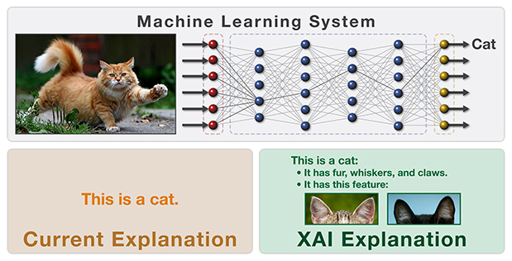
Interpretability/Explainability
From https://www.darpa.mil/program/explainable-artificial-intelligence

Slide 167
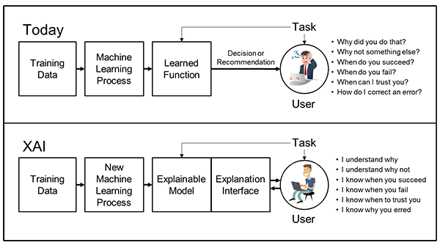
Interpretability/Explainability
From https://www.darpa.mil/program/explainable-artificial-intelligence

Slide 168
Outline
Informed Consent
Reproducibility
p-value Hacking
Who owns the data?
Privacy & Anonymity
Algorithmic fairness
Some other issues
Data Science in Industry

Slide 169
What is a data scientist?
Many types of “data scientists” in industry …
Business analysts, renamed
  “… someone who analyzes an organization or business domain (real or hypothetical) and documents its business or processes or systems, assessing the business model or its integration with technology.” – Wikipedia
Statisticians
Machine learning engineer
Backend tools developer
Thanks to: Zico Kolter

Slide 170
Key differences
Classical statistics vs machine learning approaches
(Two are nearly mixed in most job calls you will see.)
Developing data science tools vs. doing data analysis
Working on a core business product vs more nebulous “identification of value” for the firm

Slide 171
Finding a job
Make a personal website.
Free hosting options: GitHub Pages, Google Sites
Pay for your own URL (but not the hosting).
Make a clean website, and make sure it renders on mobile:
  Bootstrap: https://getbootstrap.com/
  Foundation: http://foundation.zurb.com/
Highlight relevant coursework, open source projects, tangible work experience, etc
Highlight tools that you know (not just programming languages, but also frameworks like TensorFlow and general tech skills)

Slide 172
“Requirements”
Data science job postings – and, honestly, CS postings in general – often have completely nonsense requirements
The group is filtering out some noise from the applicant pool
Somebody wrote the posting and went buzzword crazy
In most cases (unless the position is a team lead, pure R&D, or a very senior role) you can work around requirements:
A good, simple website with good, clean projects can work wonders here …
Reach out and speak directly with team members
Alumni network, internship network, online forums

Slide 173
Interviewing
We saw that there is no standard for being a “data scientist” – and there is also no standard interview style …
… but, generally, you’ll be asked about the five “chunks” we covered in this class, plus core CS stuff:
Software engineering questions
Data collection and management questions (SQL, APIs, scraping, newer DB stuff like NoSQL, Graph DBs, etc)
General “how would you approach …” EDA questions
Machine learning questions (“general” best practices, but you should be able to describe DTs, RFs, SVM, basic neural nets, KNN, OLS, boosting, PCA, feature selection, clustering)
Basic “best practices” for statistics, e.g., hypothesis testing
Take-home data analysis project (YMMV)

Slide 174
Graduate school, Academia, R&D, …
Data science isn’t really an academic discipline by itself, but it comes up everywhere within and without CS
Modern science is built on a “CS and Statistics stack” …
Academic work in the area:
Outside of CS, using techniques from this class to help fundamental research in that field
Within CS, fundamental research in:
  Machine learning
  Statistics (non-pure theory)
  Databases and data management
  Incentives, game theory, mechanism design
Within CS, trying to automate data science (e.g., Google Cloud’s Predictive Analytics, “Automatic Statistician,” …)

Slide 175
Conclusions
Final project due in 2 weeks
Will send out a survey in a few days – please complete it
Sign up for remaining courses
Converting to MS

