Slide 1
Introduction to
Data Science
John P Dickerson
Lecture #2 – 08/29/2019
CMSC320
Tuesdays & Thursdays
5:00pm – 6:15pm

Slide 2
Announcements
Register on Piazza: piazza.com/umd/fall2019/cmsc320
210 have registered already
88 have not registered yet
If you were on Piazza, you’d know …
Project 0 is out! It is “due” next Wednesday evening.
Link: https://github.com/cmsc320/fall2019/tree/master/project0
We’ve also linked some reading for the week!
First quiz will be due Thursday at noon.
(Quiz should be up on ELMS now.)

Slide 3
The Data Lifecycle
Data collection
Data processing
Exploratory analysis
&
Data viz
Analysis, hypothesis testing, & ML
Insight & Policy Decision

Slide 4
Today’s Lecture
Data collection
Data processing
Exploratory analysis
&
Data viz
Analysis, hypothesis testing, & ML
Insight & Policy Decision

Slide 5
But first, snakes!
Python is an interpreted, dynamically-typed, high-level, garbage-collected, object-oriented-functional-imperative, and widely used scripting language.
Interpreted: instructions executed without being compiled into (virtual) machine instructions*
Dynamically-typed: verifies type safety at runtime
High-level: abstracted away from the raw metal and kernel
Garbage-collected: memory management is automated
OOFI: you can do bits of OO, F, and I programming
Not the point of this class!
Python is fast (developer time), intuitive, and used in industry!
*you can compile Python source, but it’s not required

Slide 6
The Zen of Python
Beautiful is better than ugly.
Explicit is better than implicit.
Simple is better than complex.
Complex is better than complicated.
Flat is better than nested.
Sparse is better than dense.
Readability counts.
Special cases aren't special enough to break the rules …
… although practicality beats purity.
Errors should never pass silently …
… unless explicitly silenced.
Thanks: SDSMT ACM/LUG

Slide 7
Literate Programming
Literate code contains in one document:
the source code;
text explanation of the code; and
the end result of running the code.
Basic idea: present code in the order that logic and flow of human thoughts demand, not the machine-needed ordering
Necessary for data science!
Many choices made need textual explanation, ditto results.
Stuff you’ll be using in Project 0 (and beyond)!

Slide 8
Jupyter Project
Started as iPython Notebooks, a web-based frontend to the iPython Shell
  Notebook functionality separated out a few years ago
  Now supports over 40 languages/kernels
  Notebooks can be shared easily
  Can leverage big data tools like Spark
Apache Zeppelin:
  https://www.linkedin.com/pulse/comprehensive-comparison-jupyter-vs-zeppelin-hoc-q-phan-mba-
Several others including RStudio (specific to R)

Slide 9
10-minute Python primer
Define a function:
Python is whitespace-delimited
Define a function that returns a tuple:
def my_func(x, y):
if x > y:
return x
else:
return y
def my_func(x, y):
return (x-1, y+2)
(a, b) = my_func(1, 2)
a = 0; b = 4

Slide 10
Useful Built-in Functions: Counting and Iterating
len: returns the number of items of an enumerable object
range: returns an iterable object
enumerate: returns iterable tuple (index, element) of a list
https://docs.python.org/3/library/functions.html
len( [‘c’, ‘m’, ‘s’, ‘c’, 3, 2, 0] )
7
list( range(10) )
[0, 1, 2, 3, 4, 5, 6, 7, 8, 9]
enumerate( [“311”, “320”, “330”] )
[(0, “311”), (1, “320”), (2, “330”)]
Notes:
do demo

Slide 11
Useful Built-In Functions: Map and Filter
map: apply a function to a sequence or iterable
filter: returns a list* of elements for which a predicate is true
We’ll go over in much greater depth with pandas/numpy.
arr = [1, 2, 3, 4, 5]
map(lambda x: x**2, arr)
[1, 4, 9, 16, 25]
arr = [1, 2, 3, 4, 5, 6, 7]
filter(lambda x: x % 2 == 0, arr)
[2, 4, 6]
*in Python 3, returns Iterable

Slide 12
Pythonic Programming
Basic iteration over an array in Java:
Direct translation into Python:
A more “Pythonic” way of iterating:
int[] arr = new int[10];
for(int idx=0; idx<arr.length; ++idx) {
System.out.println( arr[idx] );
}
idx = 0
while idx < len(arr):
print( arr[idx] ); idx += 1
for element in arr:
print( element )

Slide 13
List comprehensions
Construct sets like a mathematician!
P = { 1, 2, 4, 8, 16, …, 2¹⁶ }
E = { x | x in ℕ and x is odd and x < 1000 }
Construct lists like a mathematician who codes!
Very similar to map, but:
You’ll see these way more than map in the wild
Many people consider map/filter not “pythonic”
They can perform differently (map is “lazier”)
P = [ 2**x for x in range(17) ]
E = [ x for x in range(1000) if x % 2 != 0 ]

Slide 14
Exceptions
Syntactically correct statement throws an exception:
tweepy (Python Twitter API) returns “Rate limit exceeded”
sqlite (a file-based database) returns IntegrityError
print('Python', python_version())
try:
cause_a_NameError
except NameError as err:
print(err, '-> some extra text')

Slide 15
Python 2 vs 3
Python 3 is intentionally backwards incompatible
(But not that incompatible)
Biggest changes that matter for us:
print “statement” → print(“function”)
1/2 = 0 → 1/2 = 0.5 and 1//2 = 0
ASCII str default → default Unicode
Namespace ambiguity fixed:
i = 1
[i for i in range(5)]
print(i) # ????????
Notes:
Prints “4” in Python 2 and “1” (i.e., unchanged because the list comprehension scope is dead) in Python 3.

Slide 16
To any Curmudgeons …
If you’re going to use Python 2 anyway, use the _future_ module:
Python 3 introduces features that will throw runtime errors in Python 2 (e.g., with statements)
_future_ module incrementally brings 3 functionality into 2
https://docs.python.org/2/library/__future__.html
from _future_ import division
from _future_ import print_function
from _future_ import please_just_use_python_3

Slide 17
So, How does Import Work?
Python code is stored in module – simply put, a file full of Python code
A package is a directory (tree) full of modules that also contains a file called __init.py__
Packages let you structure Python’s module namespace
E.g., X.Y is a submodule Y in a package named X
For one module to gain access to code in another module, it must import it

Slide 18
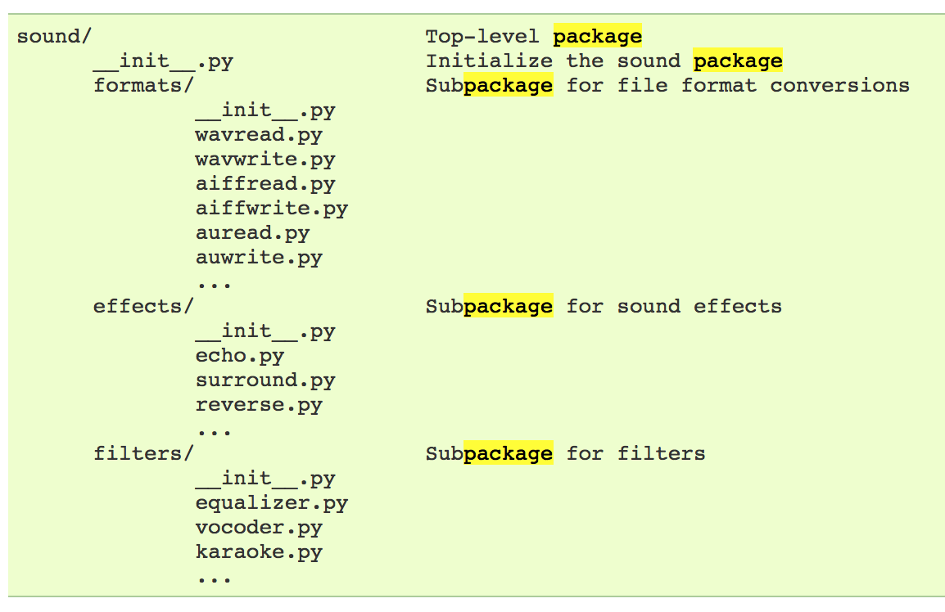
Example
# Load (sub)module sound.effects.echo
import sound.effects.echo
# Must use full name to reference echo functions
sound.effects.echo.echofilter(input, output, delay=0.7)
https://docs.python.org/2/tutorial/modules.html

Slide 19
Example
# Load (sub)module sound.effects.echo
import sound.effects.echo
# Must use full name to reference echo functions
sound.effects.echo.echofilter(input, output, delay=0.7)
# Load (sub)module sound.effects.echo
from sound.effects import echo
# No longer need the package prefix for functions in echo
echo.echofilter(input, output, delay=0.7)
# Load a specific function directly
from sound.effects.echo import echofilter
# Can now use that function with no prefix
echofilter(input, output, delay=0.7)
https://docs.python.org/2/tutorial/modules.html

Slide 20
Python vS R (For Data Scientists)
There is no right answer here!
Python is a “full” programming language – easier to integrate with systems in the field
R has a more mature set of pure stats libraries …
… but Python is catching up quickly …
… and is already ahead specifically for ML.
You will see Python more in the tech industry.

Slide 21
Extra resources
Plenty of tutorials on the web:
https://www.learnpython.org/
Work through Project 0, which will take you through some baby steps with Python and the Pandas library:
(We’ll also post some more readings soon.)
Come hang out at office hours (or chat with me privately)
All office hours will be on the website/Piazza by tomorrow.
Will have coverage MTWThF.

Slide 23
Today’s Lecture
Data collection
Data processing
Exploratory analysis
&
Data viz
Analysis, hypothesis testing, & ML
Insight & Policy Decision
with
Thanks: Zico Kolter’s 15-388, Amol Deshpande, Nick Mattei

Slide 24

What is This “data”?

Slide 25
Tabular Data
Quick teaser. We’ll go into greater depth when discussing tidy data.
Data is an abstraction of some real world entity.
Also called: instance, example, record, object, case, individual.
Each of these entities is described by a set of features.
Sometimes called variables, features, attributes, …
Can be processed into an n (number of entities) by m (number of attributes) matrix.
Result of merging & processing different records!
Picking the data that goes into this table has both technical and ethical concerns (recall: Target, Netflix, AOL examples)
ID | Title | Author | Year | Cover | Edition | Price
1 | Emma | Austen | 1815 | Paper | 20th | $5.75
2 | Dracula | Stoker | 1897 | Hard | 15th | $12.00
3 | Ivanhoe | Scott | 1820 | Hard | 8th | $25.00
4 | Kidnapped | Stevenson | 1886 | Paper | 11th | $5.00

Slide 26
Classical Statistical View of Data
There are four classical types of data
Data Types
Categorical
Numerical
Interval
Ratio
Nominal
Ordinal

Slide 27


Categorical Data: Takes a Value From a Finite Set
Nominal (aka Categorical) Data:
Values have names: describe the categories, classes, or states of things
Marital status, drink type, or some binary attribute
Cannot compare easily, thus cannot naturally order them
Ordinal Data:
Values have names: describe the categories, classes, or states of things
However, there is an ordering over the values:
  Strongly like, like, neutral, strongly dislike
Lacks a mathematical notion of distance between the values
This distinction can be blurry…
Is there an ordering over: sunny, overcast, rainy?

Slide 28
Numerical Data: Measured Using Integers or Reals
Interval Scale:
Scale with fixed but arbitrary interval (e.g., dates)
The difference between two values is meaningful:
  Difference between 9/1/2019 and 10/1/2019 is the same as the difference between 9/1/2018 and 10/1/2018
Can’t compute ratios or scales: e.g., what unit is 9/1/2019 * 8/2/2020?
Ratio Scale:
All the same properties as interval scale data, but the scale of measurement also possesses a true-zero origin
Can look at the ratio of two quantities (unlike interval)
E.g., zero money is an absolute, one money is half as much as two money, and so on

Slide 29

Numerical Data: Examples
Temperatures:
Celsius / Fahrenheit: interval or ratio scale ???????????
  Interval: 0C is not 0 heat, but is an arbitrary fixed point
  Hence, we can’t say that 30F is twice as warm as 15F.
Kelvin (K): interval or ratio scale ???????????
  Ratio: 0K is assumed to mean zero heat, a true fixed point
Weight:
Grams: interval or ratio scale ??????????
Ratio: 0g served as fixed point, 4g is twice 2g, …

Slide 30
General Rules
OK to compute.... | Nominal | Ordinal | Interval | Ratio
frequency distribution | Yes | Yes | Yes | Yes
median and percentiles | No | Yes | Yes | Yes
add or subtract | No | No | Yes | Yes
mean, standard deviation, standard error of the mean | No | No | Yes | Yes
ratio, or coefficient of variation | No | No | No | Yes
?
?
?
?
Thanks to GraphPad

Slide 31
General Rules
OK to compute.... | Nominal | Ordinal | Interval | Ratio
frequency distribution | Yes | Yes | Yes | Yes
median and percentiles | No | Yes | Yes | Yes
add or subtract | No | No | Yes | Yes
mean, standard deviation, standard error of the mean | No | No | Yes | Yes
ratio, or coefficient of variation | No | No | No | Yes
?
?
?
?

Slide 32
General Rules
OK to compute.... | Nominal | Ordinal | Interval | Ratio
frequency distribution | Yes | Yes | Yes | Yes
median and percentiles | No | Yes | Yes | Yes
addition or subtraction | No | No | Yes | Yes
mean, standard deviation, standard error of the mean | No | No | Yes | Yes
ratio, or coefficient of variation | No | No | No | Yes
?
?
?
?

Slide 33
General Rules
OK to compute.... | Nominal | Ordinal | Interval | Ratio
frequency distribution | Yes | Yes | Yes | Yes
median and percentiles | No | Yes | Yes | Yes
addition or subtraction | No | No | Yes | Yes
mean or standard deviation | No | No | Yes | Yes
ratio, or coefficient of variation | No | No | No | Yes
?
?
?
?

Slide 34
General Rules
OK to compute.... | Nominal | Ordinal | Interval | Ratio
frequency distribution | Yes | Yes | Yes | Yes
median and percentiles | No | Yes | Yes | Yes
addition or subtraction | No | No | Yes | Yes
mean or standard deviation | No | No | Yes | Yes
ratio, or coefficient of variation | No | No | No | Yes
?
?
?
?
Notes:
Coefficient of variation aka “relative standard deviation” – generally the ratio of the standard deviation to the mean of the sample – 0% = point (stdev 0 divided by mean), higher is more variable

Slide 35
General Rules
OK to compute.... | Nominal | Ordinal | Interval | Ratio
frequency distribution | Yes | Yes | Yes | Yes
median and percentiles | No | Yes | Yes | Yes
addition or subtraction | No | No | Yes | Yes
mean or standard deviation | No | No | Yes | Yes
ratio, or coefficient of variation | No | No | No | Yes
Notes:
Coefficient of variation aka “relative standard deviation” – generally the ratio of the standard deviation to the mean of the sample – 0% = point (stdev 0 divided by mean), higher is more variable

Slide 36
Data Manipulation and Computation
Data Science == manipulating and computing on data
Large to very large, but somewhat “structured” data
We will see several tools for doing that this semester
Thousands more out there that we won’t cover
Need to learn to shift thinking from:
Imperative code to manipulate data structures
to:
Sequences/pipelines of operations on data
Should still know how to implement the operations themselves, especially for debugging performance (covered in classes like 420, 424), but we won’t cover that much

Slide 37
Data Manipulation and Computation
Data Representation, i.e., what is the natural way to think about given data
Data Processing Operations, which take one or more datasets as input and produce one or more datasets as output
Indexing
Slicing/subsetting
Filter
‘map’ → apply a function to every element
’reduce/aggregate’ → combine values to get a single scalar (e.g., sum, median)
Given two vectors: Dot and cross products
One-dimensional Arrays, Vectors
0.1 | 2 | 3.2 | 6.5 | 3.4 | 4.1
“data” | ”representation” | ”i.e.”

Slide 38
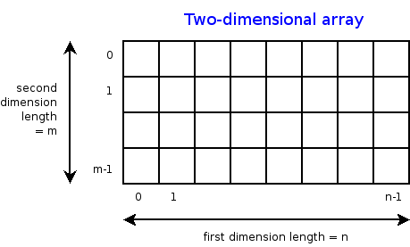
Data Manipulation and Computation
Data Representation, i.e., what is the natural way to think about given data
Data Processing Operations, which take one or more datasets as input and produce one or more datasets as output
Indexing
Slicing/subsetting
Filter
‘map’ → apply a function to every element
’reduce/aggregate’ → combine values across a row or a column (e.g., sum, average, median etc..)
n-dimensional arrays

Slide 39
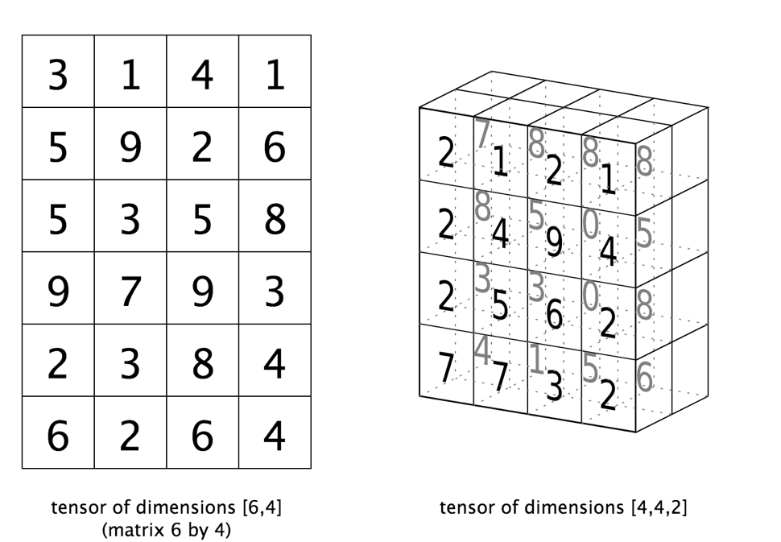
Data Manipulation and Computation
Data Representation, i.e., what is the natural way to think about given data
Data Processing Operations, which take one or more datasets as input and produce one or more datasets as output
Matrices, Tensors
n-dimensional array operations
+
Linear Algebra
Matrix/tensor multiplication
Transpose
Matrix-vector multiplication
Matrix factorization

Slide 40
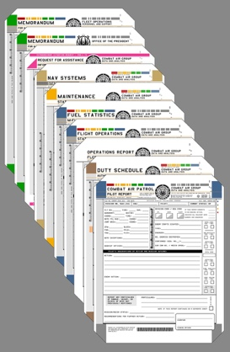
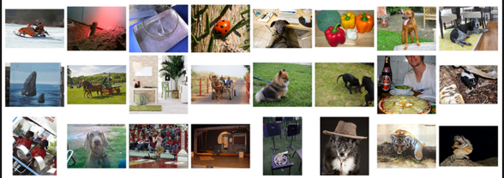
Data Manipulation and Computation
Data Representation, i.e., what is the natural way to think about given data
Data Processing Operations, which take one or more datasets as input and produce one or more datasets as output
Sets: of Objects
Filter
Map
Union
Reduce/Aggregate
Given two sets, Combine/Join using “keys”
Group and then aggregate
Sets: of (Key, Value Pairs)
(amol@cs.umd.edu,(email1, email2,…))
(john@cs.umd.edu,(email3, email4,…))

Slide 41
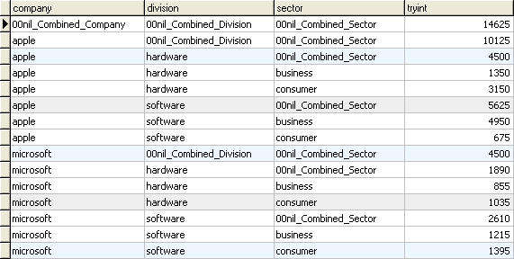
Data Manipulation and Computation
Data Representation, i.e., what is the natural way to think about given data
Data Processing Operations, which take one or more datasets as input and produce one or more datasets as output
Filter rows or columns
”Join” two or more relations
”Group” and “aggregate” them
Relational Algebra formalizes some of them
Structured Query Language (SQL)
  Many other languages and constructs, that look very similar
Tables/Relations == Sets of Tuples

Slide 42
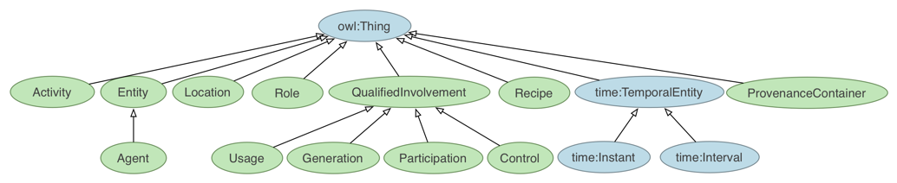
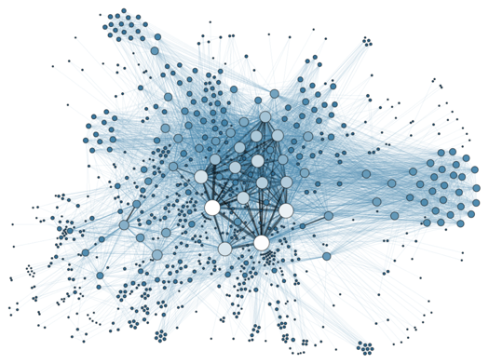
Data Manipulation and Computation
Data Representation, i.e., what is the natural way to think about given data
Data Processing Operations, which take one or more datasets as input and produce one or more datasets as output
Hierarchies/Trees/Graphs
”Path” queries
Graph Algorithms and Transformations
Network Science
Somewhat more ad hoc and special-purpose
Changing in recent years

Slide 43
Data Manipulation and Computation
Data Representation, i.e., what is the natural way to think about given data
Data Processing Operations, which take one or more datasets as input and produce
Why?
  Allows one to think at a higher level of abstraction, leading to simpler and easier-to-understand scripts
  Provides ”independence” between the abstract operations and concrete implementation
  Can switch from one implementation to another easily
For performance debugging, useful to know how they are implemented and rough characteristics

Slide 44
Next Lecture
Data collection
Data processing
Exploratory analysis
&
Data viz
Analysis, hypothesis testing, & ML
Insight & Policy Decision
… on to the “collection” part of things …

